Slide 1
SECURITY AWARENESS COURSE
by the Operations Security Professional’s Association

Slide 2
Why Security Awareness?
The World We Live In...
Is the murder of
one worker
every eight hours
acceptable as a cost of doing busines in the United States?
The next series of slides are taken from a presentation to the National Classification Management Society, Washington, D.C

Slide 3
What is Workplace Violence?
The threat or actual use of force by anyone against another person or persons in the workplace…
This includes physical attacks; any threats spoken, written or electronically transmitted; intimidating or threatening behavior; harassment; coercion; and other behavior or comments that attempts to harm or give reasonable cause to believe that it places others at risk.

Slide 4
Statistics on Workplace Violence
Is Staggering statistics
Two million victims every year
Leading cause of death at work for women -
“domestic boil-over”
Most cases go unreported
Two thirds of cases are preceded by ‘red flags’
How would you define it?
More than homicide
Verbal threats, physical attacks top the list

Slide 5
Stay Secure
No amount of prevention can stop a person who is determined to commit an act of violence in the workplace...
Being Proactive, Being Prepared
Proper planning can reduce the likelihood of an incident happening and can prepare an organization to deal with one if necessary

Slide 6

What are the warning signs?
Irrational beliefs and ideas
Unwarranted perception of unfairness
Displays of unwarranted anger
Self image of being “irreplaceable”
Isolation - depression, suicide threats
Erratic job performance, inability
to take criticism
Use of threats - verbal, non-verbal, written
History of drug or alcohol abuse
Obsession with weapons
Recent family, financial or other personal problems

Slide 7
How Will You Respond?
Do what you can to help
those around you who need help...
Make a personal commitment to
be proactive in ending this epidemic
in our society…
And remember what
matters most in this life...

Slide 8
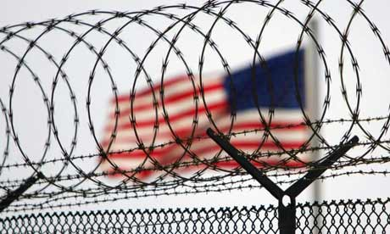
Reporting: Don’t Hesitate
In general, don’t hesitate to report anything you feel could be detrimental to the security of:
our company,
our employees,
our government customers; or
our country.

Slide 9
Security is
EVERYONE’S
BUSINESS

Slide 10

WHAT YOU WILL LEARN
BASIC SELF-DEFENSE
SECURITY AWARENESS
SECURITY AWARENESS
RISK ASSESSMENT
RISK ASSESSMENT
SITUATIONAL AWARENESS
SITUATIONAL AWARENESS
SURVEILLANCE
AWARENESS
SURVEILLANCE
AWARENESS
COUNTER-
SURVEILLANCE METHODS
COUNTER-
SURVEILLANCE METHODS
PERSONAL
PROTECTION
MEASURES
PERSONAL
PROTECTION
MEASURES

Slide 11
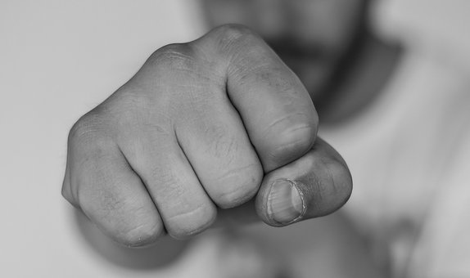
SELF DEFENSE
Basic Self-Defense
Security
Awareness
Risk
Assessment
Situational
Awareness
Surveillance
Awareness
Counter-Surveillance
Personal
Protection
Definition: the act of defending oneself or something that belongs or relates to oneself.
There might be a time that you might have to attack in order to stop an attack, but only attack in self defense of yourself or others

Slide 12
Types of Criminals
Basic Self-Defense
Security
Awareness
Risk
Assessment
Situational
Awareness
Surveillance
Awareness
Counter-Surveillance
Personal
Protection
Professionals
Plan their crimes to avoid confrontation and usually are not a physical threat unless they are provoked
Predators
Want your valuables and they don’t care if they abuse, injure or humiliate their victims
Postures
They are dangerous in the fact that they may do things that are much more dangerous than the situation demands
Psychos
Most dangerous criminal. They do not have any sane motivation for their violence and they are totally unpredictable.

Slide 13
Basic Self-Defense
Security
Awareness
Risk
Assessment
Situational
Awareness
Surveillance
Awareness
Counter-Surveillance
Personal
Protection
Self Defense Situations
Three basic types
1. Control
Someone not making threats at that moment but they are unruly or trespassing
They are causing a problem or they are refusing to leave
The person must be controlled and/or removed
Techniques cause pain but not injury while protecting you from retaliation

Slide 14
Basic Self-Defense
Security
Awareness
Risk
Assessment
Situational
Awareness
Surveillance
Awareness
Counter-Surveillance
Personal
Protection
Self Defense Situations
2. Defense against an attack
Someone is attacking you to rob you or they just enjoy fighting
Techniques must be powerful and effective
may cause serious injury or death
3. Defense of Life
Someone is trying to seriously injure you or kill you – you are fighting for your life
Techniques are powerful, effective and possibly deadly with no moral, civil or legal consideration
To any witness, your actions were necessary to protect your life

Slide 15
Basic Self-Defense
Security
Awareness
Risk
Assessment
Situational
Awareness
Surveillance
Awareness
Counter-Surveillance
Personal
Protection
Anger and Killer Instinct
DO NOT USE ANGER IN SELF DEFENSE!!!
It will only rob you of control, power and speed. Because you will not be thinking clearly and your body will be tense.
You must be prepared to fight as if your life depended on it. The overpowering desire to do whatever it takes to survive is what self defense is really about.

Slide 16
Basic Self-Defense
Security
Awareness
Risk
Assessment
Situational
Awareness
Surveillance
Awareness
Counter-Surveillance
Personal
Protection
Confrontations
Discussions
Disagreements (verbal or written)
Arguments (verbal or written)
Lawsuits
Police assistance required
Unarmed fistfights
Armed attacks
Life or death struggle (armed or unarmed)

Slide 17

Basic Self-Defense
Security
Awareness
Risk
Assessment
Situational
Awareness
Surveillance
Awareness
Counter-Surveillance
Personal
Protection
Awareness
Surroundings
Know the area or establishment that you are going to
How are you going to escape
Keep your back to a wall so it is protected

Slide 18
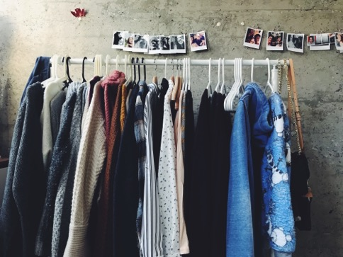
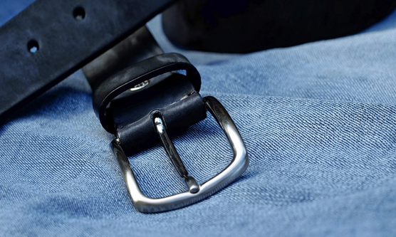
Basic Self-Defense
Security
Awareness
Risk
Assessment
Situational
Awareness
Surveillance
Awareness
Counter-Surveillance
Personal
Protection
Clothing
Is your clothing appropriate for that destination?
Is it offensive to others?
Is it too baggy?
Is it too tight?
Are your shoe soles slick or sticky? Do they limit your kicks?
Are you wearing a belt? Can you use it?

Slide 19
Basic Self-Defense
Security
Awareness
Risk
Assessment
Situational
Awareness
Surveillance
Awareness
Counter-Surveillance
Personal
Protection
Do Not Neglect the Obvious
Long Hair – easy to grab, excellent handles
High Heels – bad for running, good for kicking or stomping
Clothes
Jewelry – may hamper your defense. Necklaces, chains, pierced ears, nose, etc. Rings may help during strikes.
Hampered arms – holding packages, child, etc.

Slide 20
Basic Self-Defense
Security
Awareness
Risk
Assessment
Situational
Awareness
Surveillance
Awareness
Counter-Surveillance
Personal
Protection
Confident Non-Aggressive Movement
Eyes – keep them forward and scanning
Head – held high, confident
Shoulders – natural posture, not slouched
Hands – keep them free and in front of you
Abdomen – slightly flexed, keep spine straight
Legs – straight without being locked
Feet – lead foot about half step in front of the other foot

Slide 21
Basic Self-Defense
Security
Awareness
Risk
Assessment
Situational
Awareness
Surveillance
Awareness
Counter-Surveillance
Personal
Protection
Defensive Stance
Step back with your strong side away from the attacker
Raise your hands open to your face level and tell the person to stop
Act passive but be prepared to block an attack and then counter attack with authority
DO NOT ASSUME A FIGHTING STANCE! It give the attacker a warning of what you might do to defend yourself.

Slide 22
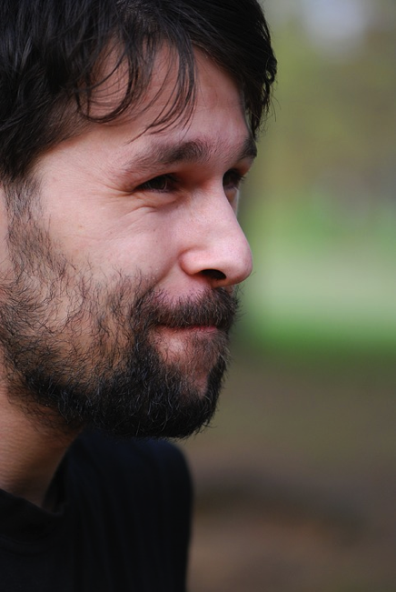
Basic Self-Defense
Security
Awareness
Risk
Assessment
Situational
Awareness
Surveillance
Awareness
Counter-Surveillance
Personal
Protection
Intimidations and Expressions
Intimidation may be worse than the attack itself
Do not be intimidated, force the situation on your terms
Express your emotions in a self defense situation. You can use real emotions or a false emotion to confuse your attacker.
Types of emotion – confidence, friendly, solemn, unconcerned contempt, shock, fear and anger.

Slide 23
Basic Self-Defense
Security
Awareness
Risk
Assessment
Situational
Awareness
Surveillance
Awareness
Counter-Surveillance
Personal
Protection
Fighting
FIGHT ON YOUR OWN TERMS!!! Not on our attackers.
Position yourself so your back is to the sun and in your opponents eyes.
Stay in control of the fight. You might get hit, but you are in control of the situation.
Do not give your intentions away on how you may fight.
Keep your arms free to move.
Once the fight begins, anything goes.

Slide 24
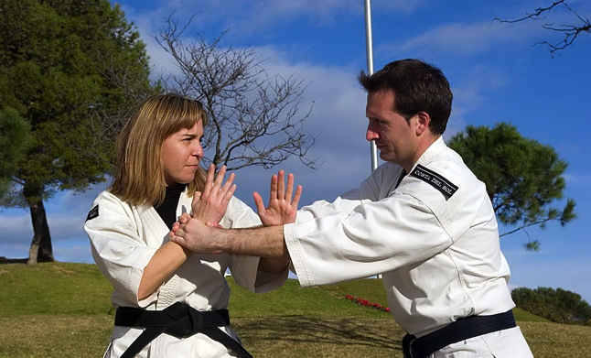
Basic Self-Defense
Security
Awareness
Risk
Assessment
Situational
Awareness
Surveillance
Awareness
Counter-Surveillance
Personal
Protection
Guarding
ALWAYS KEEP YOUR GUARD UP!!!
Even when you punch, kick, block or move.
Never leave an opening.

Slide 25
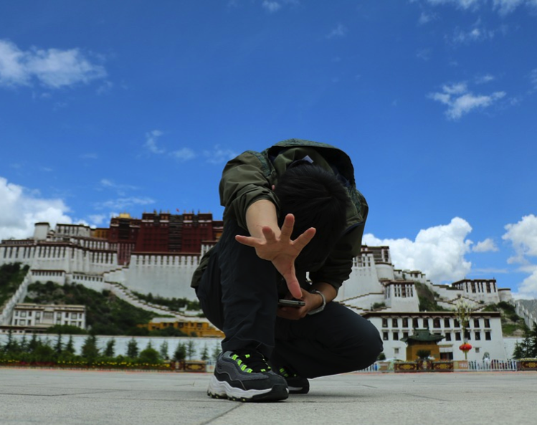
Basic Self-Defense
Security
Awareness
Risk
Assessment
Situational
Awareness
Surveillance
Awareness
Counter-Surveillance
Personal
Protection
Blocking Areas
High
Middle
Low
Left
Right

Slide 26
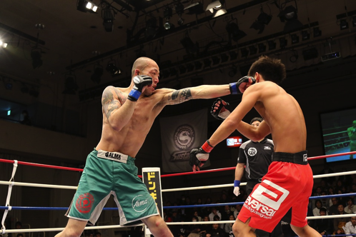
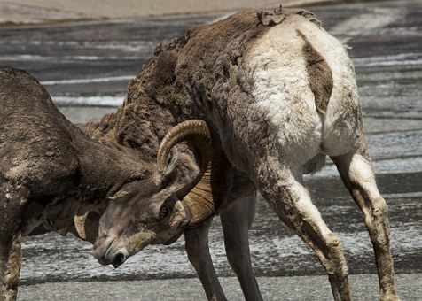
Basic Self-Defense
Security
Awareness
Risk
Assessment
Situational
Awareness
Surveillance
Awareness
Counter-Surveillance
Personal
Protection
Strikes
Eyes and throat for your lead hand
Use fingernails
Palm heel strike to chin
Solar plexus and ribs for the trailing hand
This will take the wind out of your attacker and may cause them to collapse
Groin
Knee
Instep of their lead leg for a stomp kick
Head butt
Elbow strikes to face or ribs

Slide 27
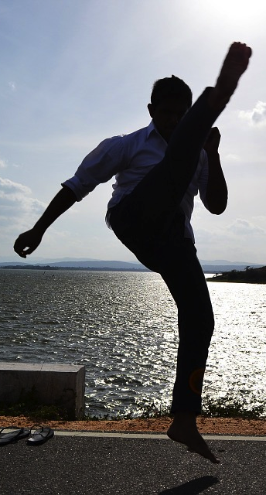
Basic Self-Defense
Security
Awareness
Risk
Assessment
Situational
Awareness
Surveillance
Awareness
Counter-Surveillance
Personal
Protection
Strikes
Things NOT to do
High kicks
Off balance
Grabbing your opponent
They can get their hands on you now
Fall to the ground
Rocks, glass, their friends

Slide 28
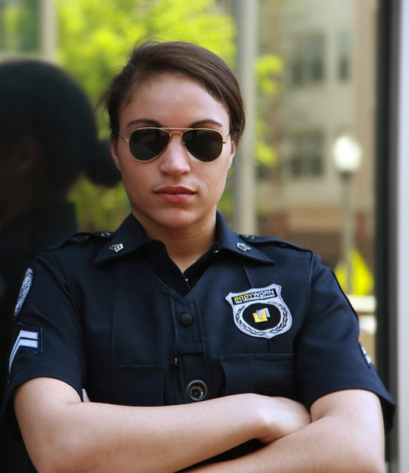
Basic Self-Defense
Security
Awareness
Risk
Assessment
Situational
Awareness
Surveillance
Awareness
Counter-Surveillance
Personal
Protection
Dealing with Law Enforcement
Notify authorities as soon as possible
Cooperate with law enforcement officers
Be polite
Be careful of apologizing or saying that your are sorry
May imply guilt

Slide 29
Basic Self-Defense
Security
Awareness
Risk
Assessment
Situational
Awareness
Surveillance
Awareness
Counter-Surveillance
Personal
Protection
Windows of Opportunity
Many different ways that an attacker can be distracted or made to hesitate and that will give you a window of opportunity.
Some internal factors that influence an attacker:
Over-confidence
Too relaxed
Thinking about the attack
Mustering up courage
Having second thoughts
Being conscious of others, cameras, security equipment, escape routes, etc

Slide 30
Basic Self-Defense
Security
Awareness
Risk
Assessment
Situational
Awareness
Surveillance
Awareness
Counter-Surveillance
Personal
Protection
Rules or no rules
Do what it takes to get yourself out of a situation.
Remember, you are responsible for your actions, even while being attacked.

Slide 31
Basic Self-Defense
Security
Awareness
Risk
Assessment
Situational
Awareness
Surveillance
Awareness
Counter-Surveillance
Personal
Protection
Three Approaches to Self Defense Training
Reaction based approach – if the attacker does “A” the defender reacts with technique “B”
Reflex based approach – the defender reflexively responds to an attack with whatever technique seems appropriate at the time
Response based approach – instead of attempting a specific technique to an attack, you take what the attacker gives you and you improvise

Slide 32
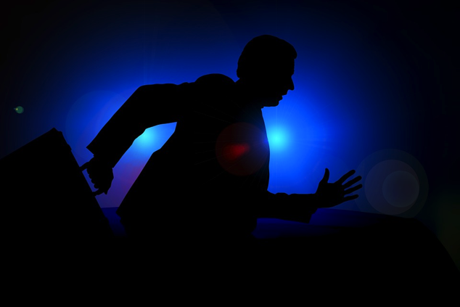
Basic Self-Defense
Security
Awareness
Risk
Assessment
Situational
Awareness
Surveillance
Awareness
Counter-Surveillance
Personal
Protection
One Last Thing
GET OUT OF THERE AS SOON AS YOU CAN – RUN AWAY!!!

Slide 33

WHAT YOU WILL LEARN
BASIC SELF- DEFENSE
BASIC SELF-DEFENSE
SECURITY AWARENESS
SECURITY AWARENESS
RISK ASSESSMENT
RISK ASSESSMENT
SITUATIONAL AWARENESS
SITUATIONAL AWARENESS
SURVEILLANCE
AWARENESS
SURVEILLANCE
AWARENESS
COUNTER-
SURVEILLANCE METHODS
COUNTER-
SURVEILLANCE METHODS
PERSONAL
PROTECTION
MEASURES
PERSONAL
PROTECTION
MEASURES

Slide 34
WHAT YOU WILL LEARN
BASIC SELF- DEFENSE
BASIC SELF-DEFENSE
SECURITY AWARENESS
RISK ASSESSMENT
RISK ASSESSMENT
SITUATIONAL AWARENESS
SITUATIONAL AWARENESS
SURVEILLANCE
AWARENESS
SURVEILLANCE
AWARENESS
COUNTER-
SURVEILLANCE METHODS
COUNTER-
SURVEILLANCE METHODS
PERSONAL
PROTECTION
MEASURES
PERSONAL
PROTECTION
MEASURES

Slide 35


SECURITY AWARENESS
Basic Self-Defense
Security
Awareness
Risk
Assessment
Situational
Awareness
Surveillance
Awareness
Counter-Surveillance
Personal
Protection
Measures that you undertake in order to stay secure
PHYSICAL SECURITY
COMPUTER SECURITY

Slide 36
PHYSICAL SECURITY
Basic Self-Defense
Security
Awareness
Risk
Assessment
Situational
Awareness
Surveillance
Awareness
Counter-Surveillance
Personal
Protection
Physical Security
Computer
Security
Goal: Physical security provides protection for the building, other building structures, or a vehicle housing the system, and/or other network components.

Slide 37
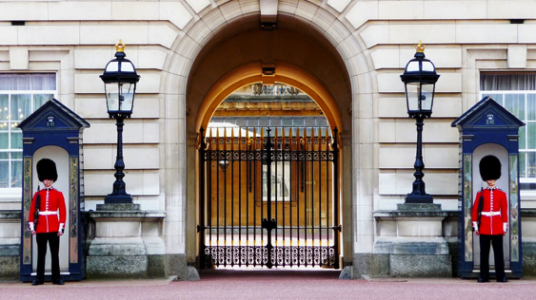
Basic Self-Defense
Security
Awareness
Risk
Assessment
Situational
Awareness
Surveillance
Awareness
Counter-Surveillance
Personal
Protection
Scope
Physical Security
Computer
Security
Perimeter Fences
Antiterrorism
Employee and visitor access controls
Badging
Intrusion Detection Systems Guards/patrols
Prohibited items
Entry/exit inspections
Escorting
Local procedure

Slide 38
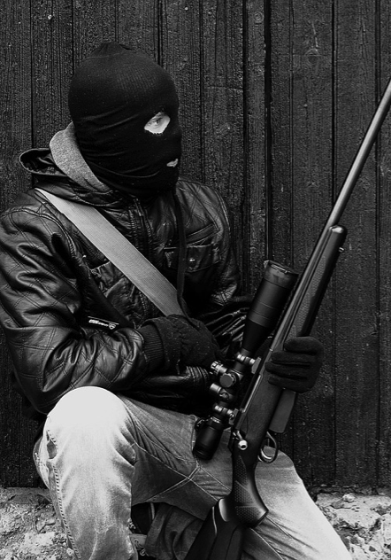
Basic Self-Defense
Security
Awareness
Risk
Assessment
Situational
Awareness
Surveillance
Awareness
Counter-Surveillance
Personal
Protection
Threat and Physical Security
Physical Security
Computer
Security
Physical Attacks require little resources
Insider threat very real
Disgruntled employee
Agent for hire
Tactics well known and hard to stop
World Trade Center
Aldrich Aimes
Financial network facilities viable target
Target information readily available
The next series of slides are taken from a presentation from Carnegie Mellon University

Slide 39
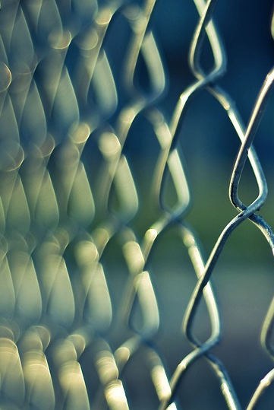
Basic Self-Defense
Security
Awareness
Risk
Assessment
Situational
Awareness
Surveillance
Awareness
Counter-Surveillance
Personal
Protection
Physical Barriers
Physical Security
Computer
Security
Fences
Guards
Alarms
Locks
Restricted Access Technologies
Biometrics
Coded Entry
Badging
Signal Blocking (Faraday Cages)

Slide 40
Basic Self-Defense
Security
Awareness
Risk
Assessment
Situational
Awareness
Surveillance
Awareness
Counter-Surveillance
Personal
Protection
Outer Protective Barriers
Physical Security
Computer
Security
Structure
Fencing, gates, other barriers
Environment
Lighting, signs, alarms
Purpose
Define property line and discourage trespassing
Provide distance from threats

Slide 41
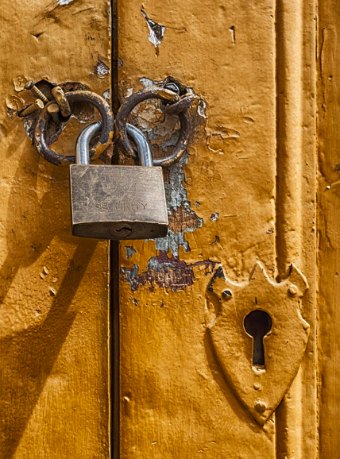
Basic Self-Defense
Security
Awareness
Risk
Assessment
Situational
Awareness
Surveillance
Awareness
Counter-Surveillance
Personal
Protection
Middle Protective Barriers
Physical Security
Computer
Security
Structure
Door controls, window controls
Ceiling penetration
Ventilation ducts
Elevator Penthouses
Environment
Within defined perimeter, positive controls
Purpose
Alert threat, segment protection zones

Slide 42
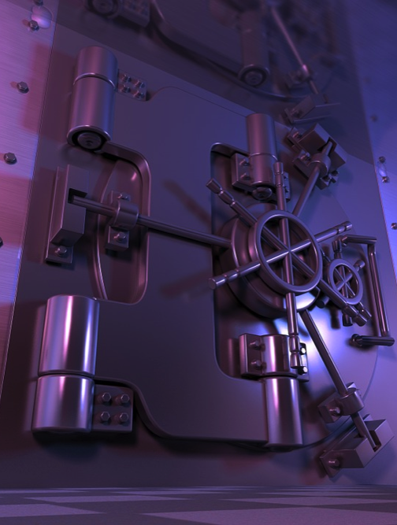
Basic Self-Defense
Security
Awareness
Risk
Assessment
Situational
Awareness
Surveillance
Awareness
Counter-Surveillance
Personal
Protection
Inner Protective Barriers
Physical Security
Computer
Security
Several layers
Structure
Door controls, biometrics
Signs, alarms, cctv
Safes, vaults
Environment
Authorized personnel only
Purpose
Establish controlled areas and rooms

Slide 43
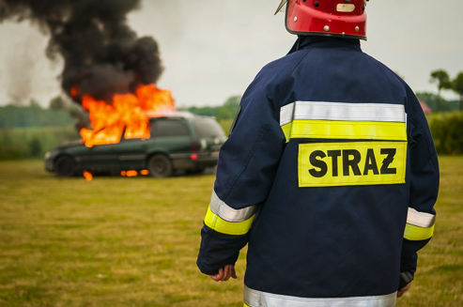
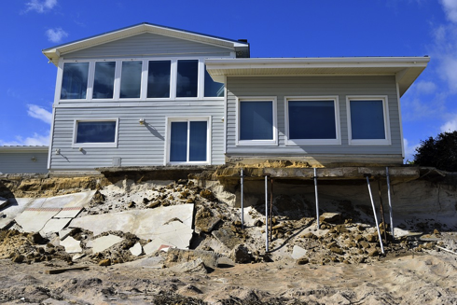
Basic Self-Defense
Security
Awareness
Risk
Assessment
Situational
Awareness
Surveillance
Awareness
Counter-Surveillance
Personal
Protection
Other Barrier Issues
Physical Security
Computer
Security
Handling of trash or scrap
Fire:
Temperature
Smoke
Pollution:
CO
Radon
Flood
Earthquake

Slide 44
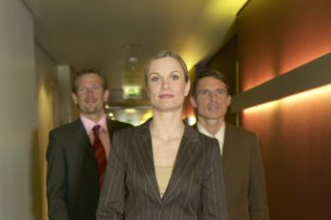
Basic Self-Defense
Security
Awareness
Risk
Assessment
Situational
Awareness
Surveillance
Awareness
Counter-Surveillance
Personal
Protection
Suspicious People
Physical Security
Computer
Security
LOOK FOR
Any person without an employee badge, visitor badge or uniform.
The next series of slides are taken from a presentation from CPAT Training

Slide 45
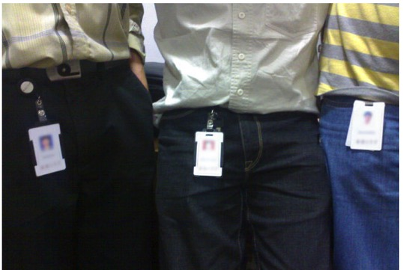
Basic Self-Defense
Security
Awareness
Risk
Assessment
Situational
Awareness
Surveillance
Awareness
Counter-Surveillance
Personal
Protection
Suspicious People
Physical Security
Computer
Security
Determine if the person is an employee or a visitor
If an employee, remind them always to display their ID badge and uniform.
If a visitor, escort them to the reception area or to the person with whom they are visiting.
Report the incident to your immediate supervisor.

Slide 46
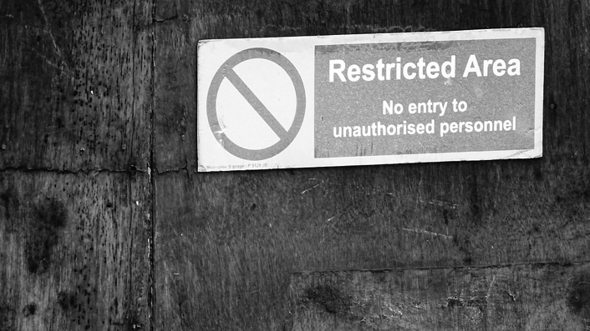
Basic Self-Defense
Security
Awareness
Risk
Assessment
Situational
Awareness
Surveillance
Awareness
Counter-Surveillance
Personal
Protection
Suspicious People
Physical Security
Computer
Security
LOOK FOR
Any person in unauthorized/restricted areas
Notes:
If you identify an individual in an area he/she is prohibited from entering,

Slide 47

Basic Self-Defense
Security
Awareness
Risk
Assessment
Situational
Awareness
Surveillance
Awareness
Counter-Surveillance
Personal
Protection
Suspicious People
Physical Security
Computer
Security
AND ACT
Get them out of the area
If a visitor, escort them to the reception area
Report the incident to your immediate supervisor

Slide 48
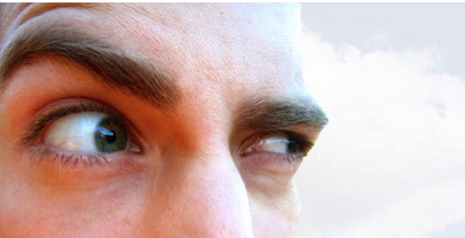
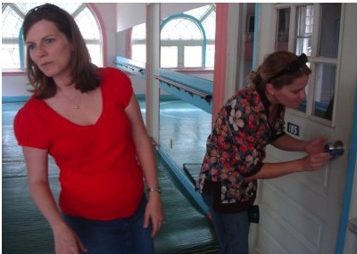
Basic Self-Defense
Security
Awareness
Risk
Assessment
Situational
Awareness
Surveillance
Awareness
Counter-Surveillance
Personal
Protection
Suspicious People
Physical Security
Computer
Security
LOOK FOR
Any person:
wearing an overcoat on a 95 degree day, or any kind of inappropriate clothing
waiting or loitering in an area or hallway
asking for an unknown department, person or employee
Notes:
Look for suspicious persons which may include an individual wearing an overcoat on a 75 degree day, someone waiting in the hallway, someone asking for an employee that doesn’t work here.

Slide 49
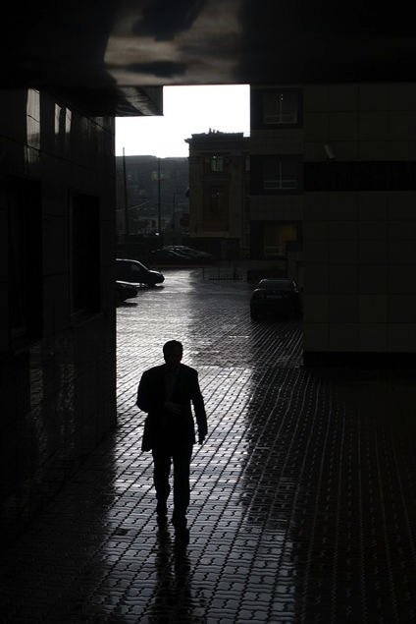
Basic Self-Defense
Security
Awareness
Risk
Assessment
Situational
Awareness
Surveillance
Awareness
Counter-Surveillance
Personal
Protection
Suspicious People
Physical Security
Computer
Security
LOOK FOR
Any person:
who seems not to belong in the area
going door to door, office to office
entering a private office unescorted
selling items
who seems lost
Notes:
Look for anyone that you’ve never seen in the building, peeking in offices, entering an office unescorted, someone that seems to be lost.

Slide 50
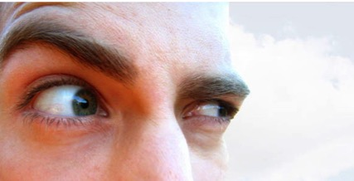
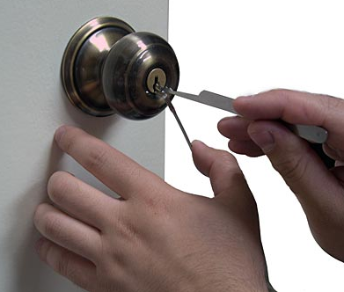
Basic Self-Defense
Security
Awareness
Risk
Assessment
Situational
Awareness
Surveillance
Awareness
Counter-Surveillance
Personal
Protection
Suspicious People
Physical Security
Computer
Security
LOOK FOR
Any person:
Tampering with somebody’s desk, boxes, personal items, equipment, vehicles, cameras, lights…
running, especially if carrying something
hiding behind doors, fences, desks, …

Slide 51
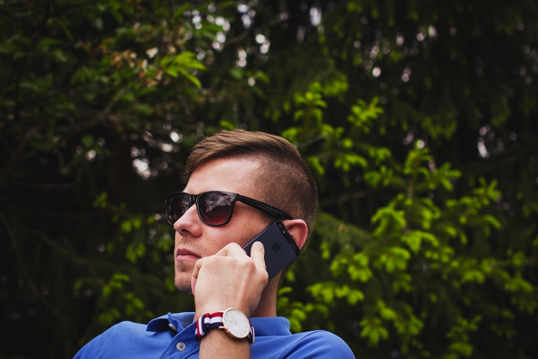
Basic Self-Defense
Security
Awareness
Risk
Assessment
Situational
Awareness
Surveillance
Awareness
Counter-Surveillance
Personal
Protection
Suspicious People
Physical Security
Computer
Security
AND ACT IMMEDIATELY!
Report the incident to your immediate supervisor

Slide 52
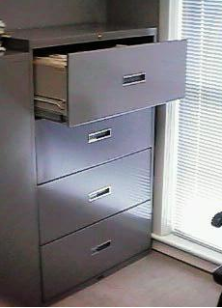
Basic Self-Defense
Security
Awareness
Risk
Assessment
Situational
Awareness
Surveillance
Awareness
Counter-Surveillance
Personal
Protection
Suspicious Activity
Physical Security
Computer
Security
LOOK FOR
Objects obstructing access points
Disconnected or obstructed cameras
Broken locks or access control systems
Unexplained clutter or debris
Objects thrown from a vehicle, especially while traveling at a high speed.

Slide 53
Basic Self-Defense
Security
Awareness
Risk
Assessment
Situational
Awareness
Surveillance
Awareness
Counter-Surveillance
Personal
Protection
Suspicious Objects & Packages
Physical Security
Computer
Security
LOOK FOR
Unexplained objects or packages that look strange or do not belong to the area
Strange markings on boxes (unknown code, color) or strange characteristics (weight, number, odd shape)
Strange leaking substance (powder, liquid, etc…)
Suspicious objects in the middle of an area (e.g., hallway, lobby, etc.)

Slide 54
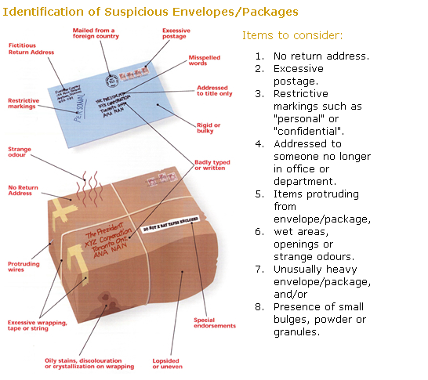
Basic Self-Defense
Security
Awareness
Risk
Assessment
Situational
Awareness
Surveillance
Awareness
Counter-Surveillance
Personal
Protection
Suspicious Objects & Packages
Physical Security
Computer
Security

Slide 55
Basic Self-Defense
Security
Awareness
Risk
Assessment
Situational
Awareness
Surveillance
Awareness
Counter-Surveillance
Personal
Protection
Suspicious Objects & Packages
Physical Security
Computer
Security
AND ACT IMMEDIATELY!
Report the suspicious box or package to your immediate supervisor

Slide 56

Basic Self-Defense
Security
Awareness
Risk
Assessment
Situational
Awareness
Surveillance
Awareness
Counter-Surveillance
Personal
Protection
Suspicious Objects & Packages
Physical Security
Computer
Security
Handle with care. Don’t shake or bump
Isolate and look for indicators (shape, color, smell)
Don’t open, smell, lick or taste

Slide 57
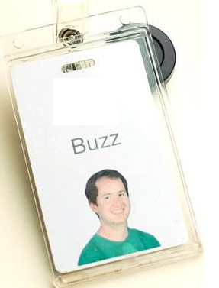
Basic Self-Defense
Security
Awareness
Risk
Assessment
Situational
Awareness
Surveillance
Awareness
Counter-Surveillance
Personal
Protection
Employee Identification
Physical Security
Computer
Security
Your Responsibilities
While on company property
Your company identification badge must be properly displayed and worn at all times.
Your company uniform (if applicable) must be worn at all times.
Properly secure and protect your ID badge, uniform, keys and access control card, etc.

Slide 58
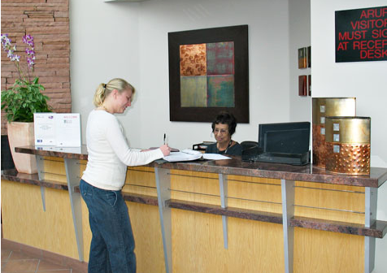
Basic Self-Defense
Security
Awareness
Risk
Assessment
Situational
Awareness
Surveillance
Awareness
Counter-Surveillance
Personal
Protection
Visitor Control
Physical Security
Computer
Security
Visitor Pre-meeting Requirements
Inform your visitor of the company’s visitor policies including photo identification, check in with receptionist prior to their visit.
Visitor Entrance Requirements
Ensure that your visitor has logged in and has been issued a visitor badge

Slide 59
Basic Self-Defense
Security
Awareness
Risk
Assessment
Situational
Awareness
Surveillance
Awareness
Counter-Surveillance
Personal
Protection
Visitor Control
Physical Security
Computer
Security
Visitor Escort Requirements
You must escort your visitors at ALL times
Do not leave your visitor unattended
Visitor Exit Requirements
Ensure that your visitor has logged out and has returned the visitor badge to the guard or receptionist

Slide 60
Basic Self-Defense
Security
Awareness
Risk
Assessment
Situational
Awareness
Surveillance
Awareness
Counter-Surveillance
Personal
Protection
Visitor Control/Receptionist Responsibility
Physical Security
Computer
Security
Visitor Entrance
Notify
hosting
employee
Document
arrival on
visitor log
Check
photo
ID
Issue
visitor
badge
Visitor Exit
Collect
visitor
badge
Document
departure on
visitor log
Notes:
Security personnel, the receptionist or a designated employee must adequately control the issuance and collection of visitor badges.
All visitors must be escorted and visibly display their visitor badge.

Slide 61
COMPUTER SECURITY
Basic Self-Defense
Security
Awareness
Risk
Assessment
Situational
Awareness
Surveillance
Awareness
Counter-Surveillance
Personal
Protection
Physical Security
Computer
Security
Goal: Computer security ensures that we stay safe from threats such as violation of privacy and malicious software on the web
The next series of slides is taken from Security Awareness Briefing by Enterprise Information Services, Inc. (EIS), EAGLE Enterprise Joint Venture (EEJV), Alliant Enterprise Joint Venture (AEJV)

Slide 62
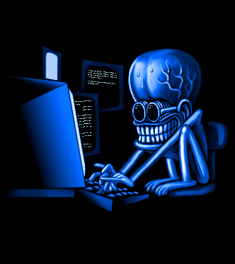
Basic Self-Defense
Security
Awareness
Risk
Assessment
Situational
Awareness
Surveillance
Awareness
Counter-Surveillance
Personal
Protection
Possible Threats
Physical Security
Physical Security
Computer
Security
Hackers, Crackers,
Malicious Code
Viruses, Worms, Trojans,
Logic Bombs
Social Engineering, Phishing
Pharming
Botnets, Man-in-the-Middle, Rootkits
Terrorism, Internet Access
Insider Threat
Computer
Security

Slide 63
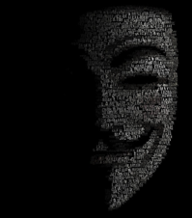

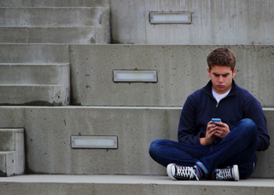


Basic Self-Defense
Security
Awareness
Risk
Assessment
Situational
Awareness
Surveillance
Awareness
Counter-Surveillance
Personal
Protection
Hackers, Crackers, Malicious Code
Physical Security
Computer
Security
Cracker
Computer-savvy
programmer creates
attack software
Malware package
$1K-2K
1 M Email addresses = $8
10,000 PCs = $1000
Script Kiddies
Unsophisticated computer users who know how to
execute programs
Criminals
Create & sell bots -> spam
Sell credit card numbers
System Administrators
Some scripts are useful
to protect networks

Slide 64


Basic Self-Defense
Security
Awareness
Risk
Assessment
Situational
Awareness
Surveillance
Awareness
Counter-Surveillance
Personal
Protection
Virus, Worms, Trojans, Logic Bombs
Physical Security
Computer
Security
Virus
Executes immediately when program is opened. Causes computer crash/ loss of data
Worm
Replicates itself and spreads using network connection
Trojan Horse
Masquerades as beneficial program e.g. games
May send your password online
Logic Bomb
Executes when certain conditions are met

Slide 65
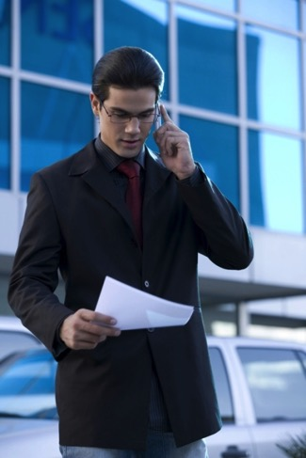

Basic Self-Defense
Security
Awareness
Risk
Assessment
Situational
Awareness
Surveillance
Awareness
Counter-Surveillance
Personal
Protection
Social Engineering
Physical Security
Computer
Security
Social engineering manipulates people into performing actions or divulging confidential information.
Email:
ABC Bank has
noticed a
problem with
your account…
Phone Call:
This is John, the System Admin. What is your password?
In Person:
What ethnicity are you? Your mother’s maiden name?
I have come to repair your machine…
and have some software patches
Notes:
Social Engineering can occur in-person, over the phone, in emails or fake web pages.
Social Engineering: non-technical or low-technology means - such as lies, impersonation, tricks, bribes, blackmail, and threats - used to attack information systems.
The next two slides discuss two types of Social Engineering: phishing and pharming.

Slide 66
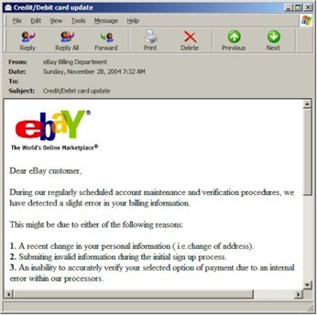
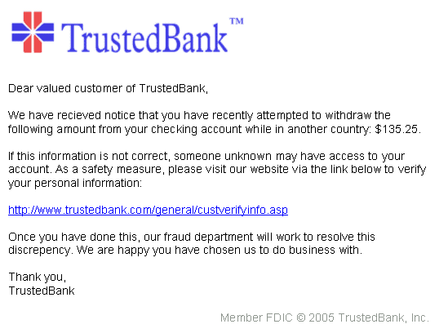
Basic Self-Defense
Security
Awareness
Risk
Assessment
Situational
Awareness
Surveillance
Awareness
Counter-Surveillance
Personal
Protection
Phishing and Pharming
Physical Security
Computer
Security
Phishing (fake email)
A ‘trustworthy entity’ asks via e-mail for sensitive information such as SSN, credit card numbers, login IDs or passwords.
Pharming (fake web pages)
The link provided in the e-mail leads to a fake webpage which collects important information and submits it to the owner.
The fake web page looks like the real thing

Slide 67
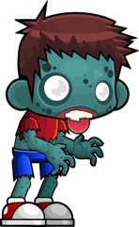

Basic Self-Defense
Security
Awareness
Risk
Assessment
Situational
Awareness
Surveillance
Awareness
Counter-Surveillance
Personal
Protection
Botnets, Man-in-the-Middle, Rootkits
Physical Security
Computer
Security
Botnet
large number of compromised computers called “zombies” are used to create and send spam or viruses or flood a network with messages as a denial of service attack
Man-in-the-Middle
An attacker pretends to be your final destination on the network. If a person tries to connect to a specific WLAN access point or web server, an attacker can mislead him to his computer, pretending to be that access point or server.
Rootkit
A collection of program hacker installs to provide easy access for the hacker or keystroke logger. It eliminates evidence of break-in and modifies the operating system

Slide 68
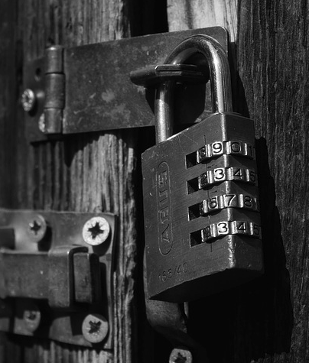
How to stay secure
Basic Self-Defense
Security
Awareness
Risk
Assessment
Situational
Awareness
Surveillance
Awareness
Counter-Surveillance
Personal
Protection
Physical Security
Computer
Security
Safeguarding PII
Protecting your system
Tools to stay secure
Recognizing and dealing with malicious software
Protecting your computer
Creating a good password
Backing up important information
Other responsibilities

Slide 69
Basic Self-Defense
Security
Awareness
Risk
Assessment
Situational
Awareness
Surveillance
Awareness
Counter-Surveillance
Personal
Protection
Safeguarding PII
Physical Security
Computer
Security
Personally Identifiable information (PII) is any information that relates to you as an individual.
“High risk” PII which may cause harm to an individual if lost/compromised
Financial information
- bank account #, credit card #, bank routing #
Medical Data
- diagnoses, treatment, medical history
Full Social Security Number
- use of truncated SSN is better but still a risk
NSPS/Personnel ratings and pay pool
information
Place and date of birth
Mother’s maiden name
Passport #
Numerous low risk PII elements when
aggregated and linked to a name
Low Risk PII:
Business related PII, all releasable under FOIA or authorized use under DON policy and considered “low risk”
Badge number
Job title
Pay grade
Office phone number
Office address
Office email address
Full name

Slide 70
Basic Self-Defense
Security
Awareness
Risk
Assessment
Situational
Awareness
Surveillance
Awareness
Counter-Surveillance
Personal
Protection
Wisconsin 134.98
Data Breach Notification Law
Physical Security
Computer
Security
Restricted data includes:
Social Security Number
Driver’s license # or state ID #
Financial account number (credit/debit) and access code/password
DNA profile (Statute 939.74)
Biometric data
In US, HIPAA protects:
Health status, treatment, or payment

Slide 71
Basic Self-Defense
Security
Awareness
Risk
Assessment
Situational
Awareness
Surveillance
Awareness
Counter-Surveillance
Personal
Protection
Safeguarding PII
Physical Security
Computer
Security
Loss or compromise of PII may result in identity theft
Identity theft is real
FTC reports that 8M+ of US adults have experienced identity theft
Crimes are still more offline than online
½ of all identity thieves were known by the victim; ¼ were dishonest employees
SSN’s are the most valuable commodity for an identity thief

Slide 72
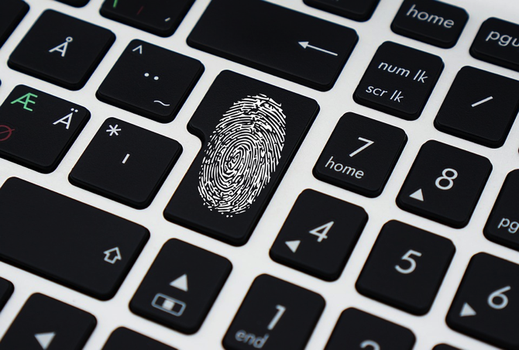
Basic Self-Defense
Security
Awareness
Risk
Assessment
Situational
Awareness
Surveillance
Awareness
Counter-Surveillance
Personal
Protection
Safeguarding PII
Physical Security
Computer
Security
Report any breach of PII (loss or compromise) immediately

Slide 73

Protecting your system
Basic Self-Defense
Security
Awareness
Risk
Assessment
Situational
Awareness
Surveillance
Awareness
Counter-Surveillance
Personal
Protection
Physical Security
1. Guard against malicious code in email
Don’t open attachments/links unless you are sure they are safe
Don’t trust who email is from
2. Guard against malicious code from web browsing
Computer
Security

Slide 74
Protecting your system
Basic Self-Defense
Security
Awareness
Risk
Assessment
Situational
Awareness
Surveillance
Awareness
Counter-Surveillance
Personal
Protection
Physical Security
Computer
Security
3. Only download music or software from pages you trust
4. No instant messaging (IM)
5. No cryptography
6. Create a good password and change regularly.
7. Avoid logging in as administrator

Slide 75

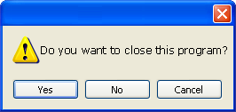
Basic Self-Defense
Security
Awareness
Risk
Assessment
Situational
Awareness
Surveillance
Awareness
Counter-Surveillance
Personal
Protection
Protecting your system
Physical Security
Computer
Security
8. Pop-up blockers do not always block ALL pop-ups so always close a pop-up window using the ‘X’ in the upper corner. Never click “yes,” “accept” or even “cancel”
9. Do not join mailing lists unless you trust the website.
10. Frequently delete temp files, cookies, history, saved passwords etc.
Notes:
A pop-up blocker should be installed (many browsers have them as add-ons), but they do not always block all pop-ups
Do not respond to pop ups while working online. For example, a malicious pop up message may say that you have a virus on the system. Close it by clicking on X in the upper right corner. If you click OK, it might install spyware or other malicious code.’
Infected USB drives are often left unattended by hackers in public places. They intend for unsuspecting people to take the USB home or to the office and unknowingly install the worm or malicious code.

Slide 76
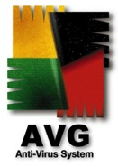
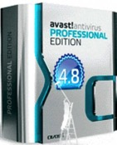
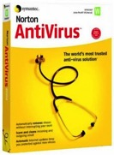
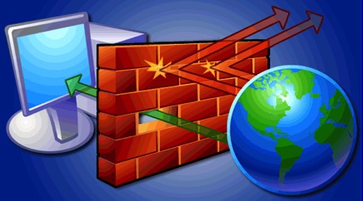
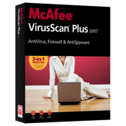

Basic Self-Defense
Security
Awareness
Risk
Assessment
Situational
Awareness
Surveillance
Awareness
Counter-Surveillance
Personal
Protection
Tools to stay secure
Physical Security
Computer
Security
Antivirus software
detects malware and can destroy it before any damage is done
Install and maintain anti-virus and anti-spyware software
Be sure to keep anti-virus software updated
Many free and pay options exist
Firewall
acts as a wall between your computer/private network and the internet. A firewall prevents hacker connections from entering your computer.
Filters packets that enter or leave your computer
Notes:
Attackers are always creating new viruses, so it is important that anti-virus software stay updated.
Anti-virus and anti-spyware software should be updated on a regular basis.
Anti-virus should be set to auto update at 12 midnight and then do a scan at 12:30.
Anti-spyware should be set to auto update at 2:30 am and then a full system scan should be done at 3:00 am, this procedure makes sure that only one activity is performed at a time.
If the employees work from home, they should also have anti-virus and anti-spyware installed on their home computers.

Slide 77
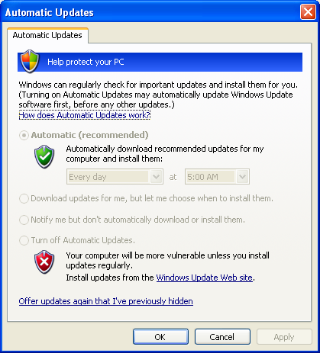
Basic Self-Defense
Security
Awareness
Risk
Assessment
Situational
Awareness
Surveillance
Awareness
Counter-Surveillance
Personal
Protection
Tools to stay secure
Physical Security
Computer
Security
Pop-up blockers
Blocks harmful pop-ups and misleading advertisements
Operation System Update
Microsoft regularly issues patches or updates to solve security problems in their software. If these are not applied, it leaves your computer vulnerable to hackers.
The Windows Update feature built into Windows can be set up to automatically download and install updates.
Notes:
Windows has automatic update features that should be turned on.
Operating system should be regularly updated with the latest patches and updates provided by the vendors.
Major software applications like Microsoft Office should also be regularly updated.
Other installed business applications should also be updated on a regular basis.
Never use an admin account to surf the web, since in case of a compromise the malicious code would have admin rights.

Slide 78
Basic Self-Defense
Security
Awareness
Risk
Assessment
Situational
Awareness
Surveillance
Awareness
Counter-Surveillance
Personal
Protection
Dealing with malicious software
Physical Security
Computer
Security
Symptoms of a break-in/ compromise
Antivirus software detects a problem
Pop-ups suddenly appear (may sell security software)
Disk space disappears
Files or transactions appear that should not be there
System slows down to a crawl
Unusual messages, sounds, or displays on your monitor
Stolen laptop (1 in 10 stolen in laptop lifetime)
Your mouse moves by itself
Your computer shuts down and powers off by itself
Often not recognized

Slide 79
Basic Self-Defense
Security
Awareness
Risk
Assessment
Situational
Awareness
Surveillance
Awareness
Counter-Surveillance
Personal
Protection
Dealing with malicious software
Physical Security
Computer
Security
Symptoms of malicious spyware:
Change to your browser homepage/start page
Ending up on a strange site when conducting a search
System-based firewall is turned off automatically
Lots of network activity while not particularly active
Excessive pop-up windows
New icons, programs, favorites which you did not add
Frequent firewall alerts about unknown programs trying to access the Internet
Bad/slow system performance

Slide 80

Basic Self-Defense
Security
Awareness
Risk
Assessment
Situational
Awareness
Surveillance
Awareness
Counter-Surveillance
Personal
Protection
Dealing with malicious software
Physical Security
Computer
Security
What to do when infected with malicious software:
use system restore
reinstall operating system

Slide 81
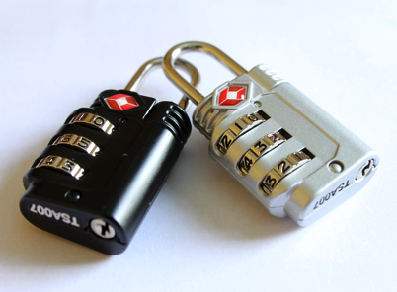
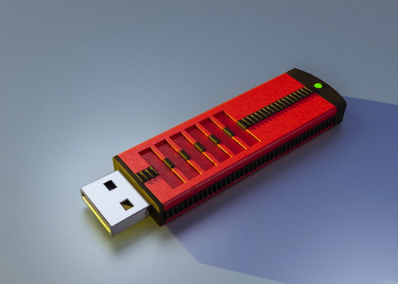
Protecting your computer
Basic Self-Defense
Security
Awareness
Risk
Assessment
Situational
Awareness
Surveillance
Awareness
Counter-Surveillance
Personal
Protection
Physical Security
Computer
Security
1. Lock your workstation when you leave your desk
CTRL+ALT+DELETE, then choose “Lock”
or
“Windows” key + L
Ensure there is a password and log off after use
2. Infected USB drives are often left unattended by hackers in public places.
3. Software Accountability
DON’T load unauthorized software
DO report any unauthorized personnel loading software on your workstation
DON’T be afraid to question technicians if you don’t know them

Slide 82
Basic Self-Defense
Security
Awareness
Risk
Assessment
Situational
Awareness
Surveillance
Awareness
Counter-Surveillance
Personal
Protection
Creating a good password
Physical Security
Computer
Security
Creating a “good password” means that your password cannot be easily guessed or cracked
At a minimum, a case sensitive 8-character mix of upper/lower case letters, numbers, and special characters, including at least two of each.
Example - it be a phrase that can be repeated when logging in:
R#1,iie2casp,bPSWDie! ….Which is derived from
Rule #1, It is easy to create a safe password, but PSWD is easier!
Do NOT use common words (Family names, dictionary words, birth dates, anniversary etc.)

Slide 83
Basic Self-Defense
Security
Awareness
Risk
Assessment
Situational
Awareness
Surveillance
Awareness
Counter-Surveillance
Personal
Protection
Creating a good password
Physical Security
Computer
Security
Merry Christmas
Bad
Password
(Lengthen)
Merry Xmas
MerryChrisToYou
(Synonym)
(Intertwine
Letters)
MerryJul
(convert vowels
to numeric)
(Abbreviate)
MaryJul
(Keypad shift
Right …. Up)
MerChr2You
MXemrays
Glad*Jes*Birth
M5rryXm1s
Mary*Jul
Good
Password
,stuzc,sd
Jq46Sjqw
mErcHr2yOu
Notes:
Bad passwords on top, good passwords on bottom.
Start with a word(s) and do some changes such as: abbreviating, keypad shift, intertwine letters, synonyms, etc.

Slide 84
Basic Self-Defense
Security
Awareness
Risk
Assessment
Situational
Awareness
Surveillance
Awareness
Counter-Surveillance
Personal
Protection
Creating a good password
Physical Security
Computer
Security
Combine 2 unrelated words | Mail + phone = m@!lf0n3
Abbreviate a phrase | My favorite color is blue= Mfciblue
Music lyric | Happy birthday to you, happy birthday to you, happy birthday dear John, happy birthday to you. hb2uhb2uhbdJhb2u
Notes:
Other password creation techniques:
Combining words using symbols and numbers
Abbreviating a phrase
Using music lyrics, poems or quotes

Slide 85

Basic Self-Defense
Security
Awareness
Risk
Assessment
Situational
Awareness
Surveillance
Awareness
Counter-Surveillance
Personal
Protection
Creating a good password
Physical Security
Computer
Security
Passwords should be changed every 60 to 90 days
Do not share your password with anyone
Do not write down your password and leave in near your computer.
Don’t use same password twice

Slide 86

Basic Self-Defense
Security
Awareness
Risk
Assessment
Situational
Awareness
Surveillance
Awareness
Counter-Surveillance
Personal
Protection
Backing up important information
Physical Security
Computer
Security
No security measure is 100%
What information is important to you?
Is your back-up:
Process Documented
Recent?
Off-site & Secure?
Tested?
Encrypted?
Notes:
Backup should be done (at least)once a week. If possible, store to a removable media.
The removable media should be big enough to hold 52 weeks of backup (e.g., 500GB).
Do a full backup once a month and store it in offsite location. This would be useful in case of a disaster in your office (fire, theft, flood, etc). On the removable media create 12 folders for each month.
Backup data should be tested periodically to ensure reliability.

Slide 87

Basic Self-Defense
Security
Awareness
Risk
Assessment
Situational
Awareness
Surveillance
Awareness
Counter-Surveillance
Personal
Protection
Other responsibilities
Physical Security
Computer
Security
Do not install unlicensed commercial software. This is a direct violation of intellectual property rights
Do not send e-mail containing racist, sexist, threatening or other objectionable language.
Do not use company e-mail for private business activities, amusement or entertainment.
Protect your work area; keep liquids away from PC/keyboard

Slide 88

Basic Self-Defense
Security
Awareness
Risk
Assessment
Situational
Awareness
Surveillance
Awareness
Counter-Surveillance
Personal
Protection
Other responsibilities
Physical Security
Computer
Security
Network Access
Be aware of visitors to your site
Only use internet for official business use
Contingency Planning
Save your work to the network drive, not local drive
Remember that you are ultimately accountable for activities that occur under your user name

Slide 89

Basic Self-Defense
Security
Awareness
Risk
Assessment
Situational
Awareness
Surveillance
Awareness
Counter-Surveillance
Personal
Protection
Other responsibilities
Physical Security
Computer
Security
. Report any potential computer security threats

Slide 90
WHAT YOU WILL LEARN
BASIC SELF- DEFENSE
BASIC SELF-DEFENSE
SECURITY AWARENESS
SECURITY AWARENESS
RISK ASSESSMENT
RISK ASSESSMENT
SITUATIONAL AWARENESS
SITUATIONAL AWARENESS
SURVEILLANCE
AWARENESS
SURVEILLANCE
AWARENESS
COUNTER-
SURVEILLANCE METHODS
COUNTER-
SURVEILLANCE METHODS
PERSONAL
PROTECTION
MEASURES
PERSONAL
PROTECTION
MEASURES

Slide 91
WHAT YOU WILL LEARN
BASIC SELF- DEFENSE
BASIC SELF-DEFENSE
SECURITY AWARENESS
RISK ASSESSMENT
SITUATIONAL AWARENESS
SITUATIONAL AWARENESS
SURVEILLANCE
AWARENESS
SURVEILLANCE
AWARENESS
COUNTER-
SURVEILLANCE METHODS
COUNTER-
SURVEILLANCE METHODS
PERSONAL
PROTECTION
MEASURES
PERSONAL
PROTECTION
MEASURES

Slide 92

RISK ASSESSMENT
Security
Awareness
Basic Self-Defense
Risk
Assessment
Situational
Awareness
Surveillance
Awareness
Counter-Surveillance
Personal
Protection
The eradication or minimisation of the adverse affects of risks to which an organisation is exposed.

Slide 93
Security
Awareness
Basic Self-Defense
Risk
Assessment
Situational
Awareness
Surveillance
Awareness
Counter-Surveillance
Personal
Protection
RISK ASSESSMENT
You have carefully thought out all the angles
You have done it a hundred times
It comes naturally to you
You know what you are doing, it is what you have been trained to do all your life
So nothing could possibly go wrong
Could it?

Slide 94

Security
Awareness
Basic Self-Defense
Risk
Assessment
Situational
Awareness
Surveillance
Awareness
Counter-Surveillance
Personal
Protection
Think Again!

Slide 95

Security
Awareness
Basic Self-Defense
Risk
Assessment
Situational
Awareness
Surveillance
Awareness
Counter-Surveillance
Personal
Protection
Why Risk Assessment?
Legislation
Employers are legally required to have done a risk assessment
suitable and sufficient
identify and quantify potential accidents
The next series of slides is taken from Security Awareness Briefing by University of Glasgow Radiation Protection Service

Slide 96

Security
Awareness
Basic Self-Defense
Risk
Assessment
Situational
Awareness
Surveillance
Awareness
Counter-Surveillance
Personal
Protection
Why Risk Assessment?
2. Good Practice
A Good Risk Assessment can:
Identify steps to prevent accidents occurring
Limit the effects of accidents
Prepare employees for coping with accidents
Draw up contingency plans

Slide 97
Security
Awareness
Basic Self-Defense
Risk
Assessment
Situational
Awareness
Surveillance
Awareness
Counter-Surveillance
Personal
Protection
Steps to do Risk Assessment
Controlling the Risk
Assessing Risk
Identufying Hazards

Slide 98

Security
Awareness
Basic Self-Defense
Risk
Assessment
Situational
Awareness
Surveillance
Awareness
Counter-Surveillance
Personal
Protection
Step 1: Hazard Identification
Identifying Hazards
Assessing
Risk
Controlling
Risk
Hazard
The potential to cause harm. Harm including ill health and injury, damage to property, plant, products or the environment, production losses or increased liabilities.

Slide 99

Security
Awareness
Basic Self-Defense
Risk
Assessment
Situational
Awareness
Surveillance
Awareness
Counter-Surveillance
Personal
Protection
How to Start
Identifying Hazards
Assessing
Risk
Controlling
Risk
Safety discussions between employers, contractors and employees
Safety information readily available for hazardous substances
Copies of the regulations
Review Accident History
Conduct preliminary job review

Slide 100


Security
Awareness
Basic Self-Defense
Risk
Assessment
Situational
Awareness
Surveillance
Awareness
Counter-Surveillance
Personal
Protection
Methods of Identifying Hazards
Identifying Hazards
Assessing
Risk
Health & safety audits
Academic journals
Research papers
Trade organisations
HSE statistics
Controlling
Risk
Similar Institutions
Outside Advice (manufacturers of equipment and materials)
Internal Advice (University Safety & Health Services)

Slide 101


Security
Awareness
Basic Self-Defense
Risk
Assessment
Situational
Awareness
Surveillance
Awareness
Counter-Surveillance
Personal
Protection
Broad Categories of Hazards
Identifying Hazards
Assessing
Risk
To help with the process of identifying hazards it is useful to categorise hazards in different ways, for example by topic, e.g.:
Mechanical
Health
Electrical
Radiation.
Substances
Fire and explosion
Controlling
Risk

Slide 102

Security
Awareness
Basic Self-Defense
Risk
Assessment
Situational
Awareness
Surveillance
Awareness
Counter-Surveillance
Personal
Protection
Hazards Prompt List
Identifying Hazards
Assessing
Risk
During work activities could the following hazards exist?
Slips/falls on the level.
Falls of persons form heights.
Falls of tools, materials, etc., from
heights.
Inadequate headroom.
Hazards associated with manual
lifting/handling of tools, materials, etc..
Hazards from plant and machinery associated with assembly, commissioning, operation, maintenance, modification, repair and dismantling.
Controlling
Risk
BS8800:1996

Slide 103

Security
Awareness
Basic Self-Defense
Risk
Assessment
Situational
Awareness
Surveillance
Awareness
Counter-Surveillance
Personal
Protection
Hazards Prompt List
Identifying Hazards
Assessing
Risk
Controlling
Risk
Vehicle hazards, covering both site transport, and travel by road.
Fire and explosion.
Violence to staff.
Substances that may be inhaled.
Substances or agents that may damage the eye.
Substances that may cause harm by coming into contact with, or being absorbed through, the skin.
Substances that may cause harm by being ingested (i.e., entering the body via the mouth).
Harmful energies (e.g., electricity, radiation, noise, vibration).
BS8800:1996

Slide 104

Security
Awareness
Basic Self-Defense
Risk
Assessment
Situational
Awareness
Surveillance
Awareness
Counter-Surveillance
Personal
Protection
Hazards Prompt List
Identifying Hazards
Assessing
Risk
Controlling
Risk
Work-related upper limb disorders resulting from frequently repeated tasks.
Inadequate thermal environment, e.g. too hot.
Lighting levels.
Slippery, uneven ground/surfaces.
Inadequate guard rails or hand rails on stairs.
Contractors' activities.
BS8800:1996

Slide 105

Security
Awareness
Basic Self-Defense
Risk
Assessment
Situational
Awareness
Surveillance
Awareness
Counter-Surveillance
Personal
Protection
Who Might be Harmed
Identifying Hazards
Assessing
Risk
Must be people specific
Employees
Contractors
Visitors
General public
Children
Trainees
People who share the workplace
Cleaners, contractors, maintenance workers
Don’t forget vulnerable groups such as people with disabilities, new or expectant mothers
Controlling
Risk

Slide 106

Security
Awareness
Basic Self-Defense
Risk
Assessment
Situational
Awareness
Surveillance
Awareness
Counter-Surveillance
Personal
Protection
Record Findings
Identifying Hazards
Assessing
Risk
Record your findings
Only a legal requirement if five or more employees
Personnel at risk – names
Description of area/task
Risks they are exposed to
Details of which hazards are significant/acceptable (and why)
Special Risks (eg 1 team member pregnant, need to work between two laboratories, control measures)
Controlling
Risk

Slide 107
Security
Awareness
Basic Self-Defense
Risk
Assessment
Situational
Awareness
Surveillance
Awareness
Counter-Surveillance
Personal
Protection
Record Findings
Identifying Hazards
Assessing
Risk
The precautions in place, or to be put in place, to reduce the significant hazards to acceptable levels
How the precautions are to be maintained (management of systems, inspection of physical precautions etc)
Details of additional risk assessments i.e. hazardous substances
Emergency Procedures
Details of person completing the risk assessment
Details of person countersigning the risk assessment
Date, school or group, location details etc.
Controlling
Risk

Slide 108

Security
Awareness
Basic Self-Defense
Risk
Assessment
Situational
Awareness
Surveillance
Awareness
Counter-Surveillance
Personal
Protection
Step 2: Assessing the Risk
Identifying Hazards
Assessing
Risk
Controlling
Risk
Risk:
The likelihood that a specified undesired event will occur due to the realisation of a hazard by, or during work activities or by the products and services created by work activities.

Slide 109
Security
Awareness
Basic Self-Defense
Risk
Assessment
Situational
Awareness
Surveillance
Awareness
Counter-Surveillance
Personal
Protection
Two Types of Assessment
Identifying Hazards
Assessing
Risk
Controlling
Risk
Subjective risk assessment
Qualitative risk assessment: involves making a formal judgement on the consequence and probability using:
Risk = Severity x Likelihood

Slide 110

Security
Awareness
Basic Self-Defense
Risk
Assessment
Situational
Awareness
Surveillance
Awareness
Counter-Surveillance
Personal
Protection
Severity of Harm
Identifying Hazards
Assessing
Risk
Information obtained about work activities is a vital input to risk assessment. When seeking to establish potential severity of harm, the following should also be considered:
Part(s) of the body likely to be affected;
Nature of the harm, ranging from slightly to extremely harmful.
Controlling
Risk
1) Slightly harmful, e.g.:
Superficial injuries; minor cuts and bruises; eye irritation from dust.
Nuisance and irritation (e.g. headaches); ill-health leading to temporary discomfort
Slightly harmful

Slide 111


Security
Awareness
Basic Self-Defense
Risk
Assessment
Situational
Awareness
Surveillance
Awareness
Counter-Surveillance
Personal
Protection
Severity of Harm
Identifying Hazards
Assessing
Risk
2) Harmful, e.g.
Lacerations; burns; concussion; serious sprains; minor fractures.
Deafness; dermatitis; asthma; work related upper limb disorders; ill-health leading to permanent minor disability.
3) Extremely harmful, e.g.
Amputations; major fractures; poisonings; multiple injuries; fatal injuries.
Occupational cancer; other severely life shortening diseases; acute fatal diseases.
Controlling
Risk
Harmful
Extremely harmful

Slide 112
Security
Awareness
Basic Self-Defense
Risk
Assessment
Situational
Awareness
Surveillance
Awareness
Counter-Surveillance
Personal
Protection
Likelihood of Harm
Identifying Hazards
Assessing
Risk
To establish likelihood of harm the adequacy of control measures already implemented and complied with needs to be considered.
Issues considered:
Number of personnel exposed.
Frequency and duration of exposure to the hazard.
Failure of services e.g. electricity and water.
Failure of plant and machinery components and safety devices.
Exposure to the elements.
Controlling
Risk

Slide 113

Security
Awareness
Basic Self-Defense
Risk
Assessment
Situational
Awareness
Surveillance
Awareness
Counter-Surveillance
Personal
Protection
Likelihood of Harm
Identifying Hazards
Assessing
Risk
Protection afforded by personal protective equipment and usage rate of personal protective equipment;
Unsafe acts (unintended errors or intentional violations of procedures) by persons, for example, who:
Controlling
Risk
1) May not know what the hazards are.
2) May not have the knowledge, physical capacity, or skills to do the work.
3) Underestimate risks to which they are exposed.
) Underestimate the practicality and utility of safe working methods.
BS8800:1996

Slide 114
Security
Awareness
Basic Self-Defense
Risk
Assessment
Situational
Awareness
Surveillance
Awareness
Counter-Surveillance
Personal
Protection
Step 3: Controlling the Risk
Identifying Hazards
Assessing
Risk
Controlling
Risk
Decide if risk is tolerable based on this table
Slightly harmful
Harmful
Extremely harmful
Highly unlikely
TRIVIAL RISK
TOLERABLE RISK
MODERATE RISK
Unlikely
TOLERABLE RISK
MODERATE RISK
SUBSTANTIAL RISK
Likely
MODERATE RISK
SUBSTANTIAL RISK
INTOLERABLE RISK

Slide 115
Security
Awareness
Basic Self-Defense
Risk
Assessment
Situational
Awareness
Surveillance
Awareness
Counter-Surveillance
Personal
Protection
Ways to Control Risk
Identifying Hazards
Assessing
Risk
Elimination of hazard
Reduce by substitution (materials, equipment etc)
Physical safeguards (machinery guarding, extraction etc)
Personal Protective Equipment
Safe working procedures
Risk Transfer – This refers to the legal assignment of the costs of certain potential losses from one party to another. The most common way is by insurance.
Combination of above
Controlling
Risk

Slide 116

Security
Awareness
Basic Self-Defense
Risk
Assessment
Situational
Awareness
Surveillance
Awareness
Counter-Surveillance
Personal
Protection
Preparing a Risk-Control Plan
Identifying Hazards
Assessing
Risk
Controlling
Risk
Written plan
Store with other safety information Discuss the program with others during development
Assure all safety concerns are met
Incorporate a system for hazard identification, risk assessment and risk control

Slide 117
Security
Awareness
Basic Self-Defense
Risk
Assessment
Situational
Awareness
Surveillance
Awareness
Counter-Surveillance
Personal
Protection
Preparing a Risk-Control Plan
Identifying Hazards
Assessing
Risk
Controlling
Risk
Ensure employees are familiar with:
the plan
safe work procedures
current legal safety and health requirements
Other components
Orientation for new employees
Safety training for new procedures
Special safeguards for young employees

Slide 118
Security
Awareness
Basic Self-Defense
Risk
Assessment
Situational
Awareness
Surveillance
Awareness
Counter-Surveillance
Personal
Protection
Preparing a Risk-Control Plan
Identifying Hazards
Assessing
Risk
Implementation, typically by asking:
Will the revised controls lead to tolerable risk levels?
Are new hazards created?
Has the most cost-effective solution been chosen?
What do people affected think about the need for, and practicality of, the revised preventive measures?
Will the revised controls be used in practice, and not ignored in the face of, for example, pressures to get the job done?
Controlling
Risk
BS8800:1996

Slide 119
Security
Awareness
Basic Self-Defense
Risk
Assessment
Situational
Awareness
Surveillance
Awareness
Counter-Surveillance
Personal
Protection
Reviewing your Assessment
Identifying Hazards
Assessing
Risk
Review your assessment and revise it if necessary
Changes leading to new hazards
Periodic review to make sure still fit for purpose
Risk assessment is a continuing process.
Controlling
Risk

Slide 120
Security
Awareness
Basic Self-Defense
Risk
Assessment
Situational
Awareness
Surveillance
Awareness
Counter-Surveillance
Personal
Protection
How it can go wrong – Case Study
Identifying Hazards
Assessing
Risk
Project studying poultry in various locations (approx 12 years)
Member of staff involved in project never used respiratory protection or considered exposure to animal allergens
Member of staff developed asthma which was later diagnosed as “occupational asthma” i.e. directly connected to the work environment
The Health and Safety Executive have inspected part of the University following a case of occupational asthma and issued the University with an “Improvement Notice” to improve RISK ASSESSMENTS!!!
Controlling
Risk

Slide 121
Security
Awareness
Basic Self-Defense
Risk
Assessment
Situational
Awareness
Surveillance
Awareness
Counter-Surveillance
Personal
Protection
How it can go wrong – Case Study
Identifying Hazards
Assessing
Risk
Controlling
Risk
Circumstances for Improvement Notice
The risk assessment for the activity did not consider the possibility of occupational asthma due to exposure to animal allergens, a condition that was foreseeable
No respiratory protection was considered or provided and no lung function tests were ever carried out (although available)
The HSE concluded that although the person involved was working on an individual project, the management of the University should have ensured that appropriate precautions were taken. They also concluded that there was no effective risk management system and that similar hazards may not have been addressed.

Slide 122
WHAT YOU WILL LEARN
BASIC SELF- DEFENSE
BASIC SELF-DEFENSE
SECURITY AWARENESS
SECURITY AWARENESS
RISK ASSESSMENT
RISK ASSESSMENT
SITUATIONAL AWARENESS
SITUATIONAL AWARENESS
SURVEILLANCE
AWARENESS
SURVEILLANCE
AWARENESS
COUNTER-
SURVEILLANCE METHODS
COUNTER-
SURVEILLANCE METHODS
PERSONAL
PROTECTION
MEASURES
PERSONAL
PROTECTION
MEASURES

Slide 123
WHAT YOU WILL LEARN
BASIC SELF- DEFENSE
BASIC SELF-DEFENSE
SECURITY AWARENESS
RISK ASSESSMENT
RISK ASSESSMENT
SITUATIONAL AWARENESS
SURVEILLANCE
AWARENESS
SURVEILLANCE
AWARENESS
COUNTER-
SURVEILLANCE METHODS
COUNTER-
SURVEILLANCE METHODS
PERSONAL
PROTECTION
MEASURES
PERSONAL
PROTECTION
MEASURES

Slide 124

SITUATIONAL AWARENESS
Security
Awareness
Risk
Assessment
Basic Self-Defense
Situational
Awareness
Surveillance
Awareness
Counter-Surveillance
Personal
Protection
Ability to observe one’s surroundings and make detailed assessments about his environment
The next series of slides are taken from the Art of Manliness

Slide 125

Why Situational Awareness
Security
Awareness
Risk
Assessment
Basic Self-Defense
Situational
Awareness
Surveillance
Awareness
Counter-Surveillance
Personal
Protection
In a dangerous situation, being aware of a threat even seconds before everyone else can keep you and your loved ones safe.

Slide 126

OODA Loop
Security
Awareness
Risk
Assessment
Basic Self-Defense
Situational
Awareness
Surveillance
Awareness
Counter-Surveillance
Personal
Protection
Developed by pilot and military strategist John Boyd.
Observe
Orient
Decide
Act

Slide 127

Observe: Condition Yellow
Security
Awareness
Risk
Assessment
Basic Self-Defense
Situational
Awareness
Surveillance
Awareness
Counter-Surveillance
Personal
Protection
Conditions by gun-fighting expert Jeff Cooper
Each color represents a person’s potential state of awareness and focus

Slide 128


Observe: Condition Yellow
Security
Awareness
Risk
Assessment
Basic Self-Defense
Situational
Awareness
Surveillance
Awareness
Counter-Surveillance
Personal
Protection
Recommended Condition: Condition Yellow (Relaxed alert)
Alert:
senses are slightly heightened
Can learn a lot about a particular scenario from the sound, sight, smell
Relaxed:
You won’t bring any unnecessary attention to yourself
Ensures maintain an open focus allowings you to take in more information about what’s going on

Slide 129

Position of Optimal Observation
Security
Awareness
Risk
Assessment
Basic Self-Defense
Situational
Awareness
Surveillance
Awareness
Counter-Surveillance
Personal
Protection
Whenever you enter an environment, put yourself in a position that will allow you to see as much as you can.
Find a place where you can view all or most of the exit points, This position readies you to make a quick getaway
If possible, put your back to the wall, this and eliminates the possibility of failing to see a threat materialize behind you.

Slide 130

Practice Situational Awareness
Security
Awareness
Risk
Assessment
Basic Self-Defense
Situational
Awareness
Surveillance
Awareness
Counter-Surveillance
Personal
Protection
Play the A-Game
When you go into a business, make note of a few things about your environment:
the number of workers behind the counter
the clothing and gender of the person sitting next to you
how many entry/exits there are, etc.
When you leave and get into the car to head home, ask your kids questions about these
It trains your kids (and you) to be more mindful of surroundings.
Master memorizing things
You can gain this skill by practicing with a deck of cards, or strings of numbers.

Slide 131

Orient: Baselines Goals Action Plans
Security
Awareness
Risk
Assessment
Basic Self-Defense
Situational
Awareness
Surveillance
Awareness
Counter-Surveillance
Personal
Protection
The Orient step provides three things to help us achieve situational awareness:
baselines and anomalies for our particular environment
mental models of human behavior we should look for
plans of action depending on our observations.

Slide 132


Establish a baseline wherever you go
Security
Awareness
Risk
Assessment
Basic Self-Defense
Situational
Awareness
Surveillance
Awareness
Counter-Surveillance
Personal
Protection
A baseline is what’s “normal” in a given situation, and it will differ from person to person and environment to environment.
E.g.
Baseline at a small coffee shop:
people reading a book
working on their computer
speaking in hushed tones with their friends
Baseline at a rock concert:
loud music
people looking at the stage
jumping up and down to the music
swaying their bodies to the beat

Slide 133

Establish a baseline wherever you go
Security
Awareness
Risk
Assessment
Basic Self-Defense
Situational
Awareness
Surveillance
Awareness
Counter-Surveillance
Personal
Protection
Baseline Questions: What’s going on here? What’s the general mood of the place? What’s the “normal” activity that I should expect here? How do most people behave here most of the time?
Anomaly Question: What would cause someone or something to stand out?

Slide 134
Behavioral Clusters to Look For
Security
Awareness
Risk
Assessment
Basic Self-Defense
Situational
Awareness
Surveillance
Awareness
Counter-Surveillance
Personal
Protection
We are not able to pay attention to everything, so we need to focus on a few things at a time.
Rely on heuristics. Heuristics are quick problem-solving and decision-making mental shortcuts our minds use to figure things out when minimal information is available and time is limited.

Slide 135

Behavioral Clusters to Look For
Security
Awareness
Risk
Assessment
Basic Self-Defense
Situational
Awareness
Surveillance
Awareness
Counter-Surveillance
Personal
Protection
Look for kinesics (people’s conscious and subconscious body language)
Three clusters of body language are of particular interest for situational awareness:
Dominance/submissive behavior
Comfortable/uncomfortable behavior
Interested/uninterested behavior

Slide 136

Dominance/ Submissive Behaviour
Security
Awareness
Risk
Assessment
Basic Self-Defense
Situational
Awareness
Surveillance
Awareness
Counter-Surveillance
Personal
Protection
Most people: Submissive (try to get along with others)
Anomaly: Dominant behavior,
an expression of the limbic system’s fight response” and often manifests itself in gestures and postures that make a person look larger to intimidate ‘smaller’ individuals into submission.
KEEP AN EYE ON DOMINANT BEHAVIOR
Extra note: If someone acts in a pushy, authoritative, or overbearing way, it doesn’t necessarily mean they’re a threat; context matters e.g. boss to act dominant in relation to their employees

Slide 137

Comfortable/Uncomfortable Behaviour
Security
Awareness
Risk
Assessment
Basic Self-Defense
Situational
Awareness
Surveillance
Awareness
Counter-Surveillance
Personal
Protection
Most people: Comforable
Anomaly: Uncomfortable behavior
Eg This is when a person looks over their shoulder to see what’s behind them or generally scans their surroundings. People who are comfortable generally don’t do this because they don’t feel any threat
KEEP AN EYE ON UNCOMFORTABLE BEHAVIOR
Extra note: Someone acting comfortable when everyone else is uncomfortable would be an anomaly. Eg Boston Marathon bombers was that they noticed in surveillance footage that the men looked relatively calm (cos they knew it) while everyone else was running around in a panic

Slide 138

Interested/ Uninterested Behaviour
Security
Awareness
Risk
Assessment
Basic Self-Defense
Situational
Awareness
Surveillance
Awareness
Counter-Surveillance
Personal
Protection
Most people: Uninterested
(not paying attention to their environment, caught up in their own thoughts)
Anomaly: Interested Behavior (individuals who are showing interest in a particular person or object)
KEEP AN EYE ON INTERESTED BEHAVIOR

Slide 139
Other Behavioral Threat Indicators
Security
Awareness
Risk
Assessment
Basic Self-Defense
Situational
Awareness
Surveillance
Awareness
Counter-Surveillance
Personal
Protection
Shifty hands
Ensure person is not holding a weapon and is not preparing to strike
Criminals often touch or pat that area on the body where that object is concealed, as if to ensure the object has not been lost or is still hidden from view
Acting Natural
People “acting natural” will appear distracted and over- or under-exaggerate their movements
E.g. Insurgents in Afghanistan will often try to act like farmers, when they’re in fact attempting to collect information on U.S. military patrols. Marine Combat Profilers are trained to look for these “farmers” who appear to be trying too hard.

Slide 140
Have a plan of action based on what you observe
Security
Awareness
Risk
Assessment
Basic Self-Defense
Situational
Awareness
Surveillance
Awareness
Counter-Surveillance
Personal
Protection
Ask yourself: “What would I do if I saw an anomaly?”
COME UP WITH AN ACTION PLAN
Eg “guy comes in with a gun.” The best course of action in this scenario depends on a few things. And knowing what those few things are requires you to be situationally aware. If the robber came in from the front door and you’re near the rear exit, your best action would be to book it out the back door right away.

Slide 141
Situational Awareness as a Preventive Tactic
Security
Awareness
Risk
Assessment
Basic Self-Defense
Situational
Awareness
Surveillance
Awareness
Counter-Surveillance
Personal
Protection
Extra: The less vulnerable you look, the less likely someone is going to mess with you.
E.g. When you’re out and about, look alert. Get your nose out of your smartphone. When you’re walking back to your car at night, have your keys at the ready and constantly scan your surroundings.

Slide 142

Situational Awareness as a Preventive Tactic
Security
Awareness
Risk
Assessment
Basic Self-Defense
Situational
Awareness
Surveillance
Awareness
Counter-Surveillance
Personal
Protection
Always keep a tactical flashlight and bust it out at night
Allows you to better observe in the darkness
Acts as a deterrent to would-be bad guys as law enforcement officers are usually the only ones shining flashlights down alleys and under cars
Worst comes to worst and you do end up getting jumped, use the tactical flashlight as a defensive tool by blinding your would-be attacker with the bright beam or even hitting him

Slide 143

Practice Practice Practice!
Security
Awareness
Risk
Assessment
Basic Self-Defense
Situational
Awareness
Surveillance
Awareness
Counter-Surveillance
Personal
Protection
Situational awareness is a mindset that you have to purposefully cultivate. You want to get to the point that it’s just something you do without having to think about it.

Slide 144
WHAT YOU WILL LEARN
BASIC SELF- DEFENSE
BASIC SELF-DEFENSE
SECURITY AWARENESS
SECURITY AWARENESS
RISK ASSESSMENT
RISK ASSESSMENT
SITUATIONAL AWARENESS
SITUATIONAL AWARENESS
SURVEILLANCE
AWARENESS
SURVEILLANCE
AWARENESS
COUNTER-
SURVEILLANCE METHODS
COUNTER-
SURVEILLANCE METHODS
PERSONAL
PROTECTION
MEASURES
PERSONAL
PROTECTION
MEASURES

Slide 145
WHAT YOU WILL LEARN
BASIC SELF- DEFENSE
BASIC SELF-DEFENSE
SECURITY AWARENESS
RISK ASSESSMENT
SITUATIONAL AWARENESS
RISK ASSESSMENT
SITUATIONAL AWARENESS
SURVEILLANCE
AWARENESS
COUNTER-
SURVEILLANCE METHODS
COUNTER-
SURVEILLANCE METHODS
PERSONAL
PROTECTION
MEASURES
PERSONAL
PROTECTION
MEASURES

Slide 146

SURVEILLANCE AWARENESS
An employee on the way to work one morning noticed a vehicle with two passengers parked in an unauthorized area at the facility. As the employee passed by the car, the passengers asked for directions to another building nearby. But, when they left the parking lot, they proceeded in a different direction.
A couple of weeks later, the employee saw the same vehicle, once again parked in the unauthorized area. The driver sped away, but the employee took down the license plate information and reported both incidents to security, including a description of the original passengers.
The next series of slides are taken from a Surveillance Awareness Course by FEMA

Slide 147

SURVEILLANCE AWARENESS
Three weeks later, a different employee observed a person videotaping the same building in an unusual manner and reported the incident. Security personnel used the building’s closed-circuit video to identify the person.
The person in the video was a match to the driver of the vehicle previously reported.

Slide 148

SURVEILLANCE AWARENESS
The security manager provided this information to law enforcement, resulting in an investigation. One of the individuals identified during the investigation was linked to a known terrorist money-laundering operation.
Because each of these separate incidents was reported, the incidents were able to be linked together as indicators of a potential terrorist attack.

Slide 149

What Is Surveillance?
The word surveillance comes from the French word for “watching over”
Adversarial surveillance is conducted to gather information about individuals, organizations, businesses, and infrastructure in order to commit terrorism, crimes against individuals, espionage, theft, stalking, and destruction of property.

Slide 150



Targets of Surveillance
Primary targets of adversarial surveillance are usually critical infrastructure assets and systems, as well as the people who frequent those locations
E.g.
Stadiums, shopping malls (places where large numbers of people gather)
power and communications systems
food and water supplies
transportation networks
financial entities and networks.
Emergency and law enforcement responders

Slide 151


New York City Surveillance
Dhiren Barot, al-Qaida operative visited New York City in April 2001 and conducted extensive surveillance of various financial targets such as New York Stock Exchage and International Monetary Fund, among other targets.

Slide 152

New York City Surveillance
Barot’s footage included scenes of the World Trade Center towers. While filming, he turned the camera on its side to simulate the buildings falling over, and Barot or an unseen man mimicked the sound of an explosion.
Despite the eerily foretelling nature of the video, Barot is not believed to have had prior knowledge of the 9/11 attacks.
Barot was sentenced to life in prison after pleading guilty to conspiracy to murder in October 2006.

Slide 153

Pre-Attack Preparation
During pre-attack preparation, terrorist activities are most vulnerable to detection and can best be halted. Depending on the scope of the attack, preparation may occur over a period of months and, in some cases, years.
Examples of pre-incident preparation activities include:
Surveillance
Security tests
Acquisition of supplies and materials
Practice or test runs

Slide 154

Information Collected Through Surveillance
The following types of information have been collected through adversarial surveillance:
The location
Routine activities of employees, suppliers, customers, and visitors
Numbers of security personnel and cameras
Facility layout, including access and egress routes, vulnerabilities
Event-specific data (relating to special events)

Slide 155

Information Collected Through Surveillance
Security/visitor processes and procedures
Security equipment, including badges and uniforms
Information about maintenance and cleaning personnel or procedures
Crowd data (i.e., when potential targets are the most crowded)
Access requirements for restricted or employee-only areas
Parking facility access and operations
Other relevant information

Slide 156

Surveillance Activities
Surveillance activities include the following:
Drawing maps or diagrams
Observing employees and facilities using vision-enhancing devices (e.g., binoculars, still and video cameras, and night vision goggles)
Soliciting employees for information
Taking notes about security and routines
Charting crowd patterns
Pocketing documents
Photographing security equipment, badges, or apparel
Observing security responses after attempting unauthorized access

Slide 157

Surveillance Activities Can Be Detected
As mentioned earlier, surveillance takes time. Surveillance may take place over several days, weeks, or longer. It may involve repeated visits.
Surveillance can be detected!

Slide 158

Trained and Untrained Operatives
Surveillance
Can be individual or team
Use variety of sophisticated surveillance equipment and multiple forms of transportation
may act as families or tourists to gain access to and probe selected targets
Experience has shown us that individuals involved in planning terrorism are not always well-trained or equipped.
Operatives who are not highly trained are more vulnerable to detection by employees, passers-by, and others.

Slide 159
How to Detect Adversarial Surveillance
1) Take note of activities you observe that are typically associated with surveillance
watching a location or recording information about it over time
2) Evaluate any surveillance-related activities that you observe to determine if they seem unusual or noteworthy. Often, you will find that surveillance activities will appear unusual and out of place.

Slide 160
Look for Unusual Activities
Normal Activities | Unusual Activities
A photographer or videographer working on assignment will take photographs openly, use professional equipment, and make efficient use of time. | A person conducting surveillance may try to hide his or her activities, use a cell phone or low-end camera, and make repeated visits.
A tourist usually will take photographs of everything that is notable in the area, and will include companions in them. | An individual conducting surveillance may focus attention on one location, and in particular building entrances, windows, or security personnel or features. If there are companions or others included, they usually are not the focus of a photo or video.

Slide 161

Evaluating Unusual Activities
Assess and evaluate the totality of observed actions and behaviors as well as other relevant circumstances
a person may be interested in building doors or entrances for a variety of innocent reasons
However, the person’s behavior is suspicious and should be reported if he displays unusual behaviors:
Making repeated visits to the same location to record or document something about the doors or entrances
Attempting to disguise an interest in the doors or entrances
Displaying more of an interest in alarm and security features or in restricted or employee-only entrance

Slide 162
Scenarios
Instructions: Review each of the following scenarios and identify what is unusual about it.
In each of the following scenarios someone has observed an unusual activity that could involve adversarial surveillance at that location.

Slide 163
Scenarios
Scenario 1: Photography From a Parked Car
Ray is crossing the street toward his workplace in the morning and sees someone taking photos of the building entrance with a camera. The person taking the photos is sitting inside a car that is parked across the street from the building. The car window is closed and the person is hunched over inside the car.
Question: What is unusual about this person’s activities?

Slide 164
Scenarios
Scenario 2: Pacing Off Distances
Ella is walking from her car in the employee parking lot. There is a young man in front of her taking long strides. When he reaches the parking lot gate, he stops and writes something in a small notebook. The young man starts walking again alongside the parking lot fence from one end to the other, stopping again at the end to write in his notebook. When he turns around and sees Ella watching, he quickly puts the notebook in his pocket and rapidly walks away.
Question: What is unusual about this person’s activities?

Slide 165
Scenarios
Scenario 3: Going Through the Trash
Marcus is walking behind his workplace when he notices a woman reaching inside a company recycling container. Her attire is much too casual for an employee. There is a stopped car nearby with someone in the driver’s seat and the engine running. The woman pulls out a handful of papers, pages through them, and puts one inside a messenger bag. She sees Marcus, then jams the other papers inside her bag, walks rapidly to the car with her head averted, and gets inside. The car speeds away.
Question: What is unusual about these activities?

Slide 166

Activities That Should Always be reported
Illegal activities
Questioning employees about security personnel, processes, procedures, and equipment.
Security tests, attempts to access employee-only or non-public areas, or an increase in alarms or events that require a security or law enforcement response.
Systems access attempts.
Thefts or attempted thefts of IDs, badges, or uniforms; smart phones, laptops, or other equipment; or vehicles.

Slide 167
Avoid Aiding and Abetting
The following activities also may be associated with gathering information about a potential target:
Questioning about building entrances where there may be no security, such as loading docks or the “back door.”
Asking or expecting an employee to hold a door open that requires a key, code, or badge to enter.
You can avoid situations where you might become an unwilling participant in surveillance activities by refusing to answer questions related to building access or allowing an unauthorized person access to restricted areas. If the person persists, inform a manager or security immediately.

Slide 168
Surveillance and Location
Persons engaged in surveillance may change location in order to appear less conspicuous and avoid detection. The locations selected typically provide access to information needed for planning an attack or other crime.
You may see the same person conducting surveillance at different locations over a period of time. For example, that person may appear outside the front of your building, inside the building, or in places where you and your coworkers gather, such as a local coffee shop or eatery.

Slide 169

Unusual Behaviour
Reacting visibly to events of interest, such as security guard movements, by moving, communicating, or taking notes.
Making sudden turns or stops, such as turning around abruptly or ducking into a doorway.
Making visible hand or other signals to communicate with others on the team.

Slide 170

Unusual Behavior
A person may be dressed inappropriately for the environment, such as:
Wearing overly casual clothing in a professional environment.
Wearing business or formal attire while claiming to be a maintenance employee.
Wearing accessories to disguise appearance.

Slide 171


Unusual Behavior and Cover Story
Two mistakes made them more visible to detection:
Running – to flee the area where they were detected
Hiding- hide their faces
Other common mistakes:
Failing to have a valid reason for being in a particular location

Slide 172
WHAT YOU WILL LEARN
BASIC SELF- DEFENSE
BASIC SELF-DEFENSE
SECURITY AWARENESS
SITUATIONAL AWARENESS
SECURITY AWARENESS
RISK ASSESSMENT
RISK ASSESSMENT
SITUATIONAL AWARENESS
SURVEILLANCE
AWARENESS
SURVEILLANCE
AWARENESS
COUNTER-
SURVEILLANCE METHODS
COUNTER-
SURVEILLANCE METHODS
PERSONAL
PROTECTION
MEASURES
PERSONAL
PROTECTION
MEASURES

Slide 173
WHAT YOU WILL LEARN
BASIC SELF- DEFENSE
BASIC SELF-DEFENSE
SECURITY AWARENESS
RISK ASSESSMENT
SITUATIONAL AWARENESS
RISK ASSESSMENT
SITUATIONAL AWARENESS
SURVEILLANCE
AWARENESS
SURVEILLANCE
AWARENESS
COUNTER-
SURVEILLANCE METHODS
PERSONAL
PROTECTION
MEASURES
PERSONAL
PROTECTION
MEASURES

Slide 174

COUNTER-SURVEILLANCE METHODS
Do you know what you should do if you see signs of adversarial surveillance?

Slide 175

To Whom Do You Report?
If you are an employee, you may need to inform your supervisor, a manager, or security personnel so that they can call your local police.
If your company is small, or you work alone, you may be the one who needs to call the local police or other law enforcement contacts.

Slide 176

What Happens to Report of Suspicious Activity?
Write down as much information about the person or vehicle you observed and any other information about the incident
Writing down the details is important—memories only stay fresh for a short time!
Your employer or local police department may already have a worksheet available for you.

Slide 177
Report Observed Activities
Your report should include your observations like:
The person was at the bus stop for longer periods than is normal.
The person did not appear to be waiting for a bus.
The person appeared to be more interested in the building that he did not look up when a bus arrived.
The person appeared at different times of the day and over several days.

Slide 178

Actions To Avoid
For employees untrained in security:
DON’T confront or aggressively question suspicious persons
DON’T attempt to physically restrain suspicious persons
DON’T attempt to confiscate equipment, such as cameras or cell phones
DON’T follow closely or obviously behind suspicious persons to obtain vehicle or other information
These undertakings may put employees at risk

Slide 179
Training
To ensure that employees remain vigilant, supervisors and managers should consider:
Implementing an employee training program
Following up the training program by asking questions to assess their understanding of the material
Making sure employees remember who to notify if they observe suspicious behavior
Regularly reviewing what to report and reporting procedures with employees
Encouraging employees to touch base as needed with supervisors and security managers after reporting an incident

Slide 180

Community Reporting Initiatives
Communities across the United States have reporting initiatives that encourage everyone to report these activities to law enforcement.
Some of these programs have been in existence for many years and may provide training as well as specific points of contact and reporting mechanisms—such as text or email applications—to report suspicious activities.
Eg “If you see something, say something” campaign

Slide 181
WHAT YOU WILL LEARN
BASIC SELF- DEFENSE
BASIC SELF-DEFENSE
SECURITY AWARENESS
SECURITY AWARENESS
RISK ASSESSMENT
RISK ASSESSMENT
SITUATIONAL AWARENESS
SITUATIONAL AWARENESS
SURVEILLANCE
AWARENESS
SURVEILLANCE
AWARENESS
COUNTER-
SURVEILLANCE METHODS
PERSONAL
PROTECTION
MEASURES
PERSONAL
PROTECTION
MEASURES

Slide 182
WHAT YOU WILL LEARN
BASIC SELF- DEFENSE
BASIC SELF-DEFENSE
SECURITY AWARENESS
RISK ASSESSMENT
SITUATIONAL AWARENESS
RISK ASSESSMENT
SITUATIONAL AWARENESS
SURVEILLANCE
AWARENESS
SURVEILLANCE
AWARENESS
COUNTER-
SURVEILLANCE METHODS
COUNTER-
SURVEILLANCE METHODS
PERSONAL
PROTECTION
MEASURES

Slide 183

Security
Awareness
Risk
Assessment
Situational
Awareness
Basic Self-Defense
Surveillance
Awareness
Counter-Surveillance
Personal
Protection
PERSONAL PROTECTION MEASURES
The next series of slides are taken from the UHCL A CALEA Accredited Law Enforcement Agency on Personal Safety

Slide 184

Security
Awareness
Risk
Assessment
Situational
Awareness
Basic Self-Defense
Surveillance
Awareness
Counter-Surveillance
Personal
Protection
Psychology of Criminal Predators
Let’s Examine Our Day:
Mentally Review Your Daily Activities
Identify Areas And Activities Where You Are Most Vulnerable
Strangers vs. Persons Known To You

Slide 185

Security
Awareness
Risk
Assessment
Situational
Awareness
Basic Self-Defense
Surveillance
Awareness
Counter-Surveillance
Personal
Protection
Psychology of Criminal Predators
Common Characteristics of Criminals
Low Self-Esteem
Extremely Selfish Attitudes
Lack of Conscience and Sense
of Mercy
View Niceness As Weakness
Blend In Well To Appear Non-Threatening And Innocent
Constantly Seeking Criminal Opportunity

Slide 186
Security
Awareness
Risk
Assessment
Situational
Awareness
Basic Self-Defense
Surveillance
Awareness
Counter-Surveillance
Personal
Protection
Mental Preparedness
Awareness Levels-Different levels for different situations
Low Level-In The Comfort of Your Home
Moderate Level-In A Familiar Area,
But Surrounded By Strangers (This is where you are most at risk because you think you are safe)
High Level-In An Unknown Area That May Be Associated With Crime

Slide 187

Security
Awareness
Risk
Assessment
Situational
Awareness
Basic Self-Defense
Surveillance
Awareness
Counter-Surveillance
Personal
Protection
Mental Preparedness
Mental Conditioning-Developing A “Mental” Plan of Action To Use In The Event You Are Confronted With Certain Situations

Slide 188

Security
Awareness
Risk
Assessment
Situational
Awareness
Basic Self-Defense
Surveillance
Awareness
Counter-Surveillance
Personal
Protection
Home Security
Is Your Home A Safe Place?
FACTS:
Majority of Sexual Assaults Take Place In Victims’ Homes
According To a U.S. Department Of Justice Study, If You Are Home When a Criminal Gains Entry, There Is a One In Three Chance of Becoming a Victim of Violence

Slide 189

Security
Awareness
Risk
Assessment
Situational
Awareness
Basic Self-Defense
Surveillance
Awareness
Counter-Surveillance
Personal
Protection
Visitors
Door Viewers
Confirm Identification
Packages (Have them left at the door)
Never Tell Visitors You Are Alone
Don’t Broadcast Your Plans In Public
Don’t let strangers in your home.

Slide 190

Security
Awareness
Risk
Assessment
Situational
Awareness
Basic Self-Defense
Surveillance
Awareness
Counter-Surveillance
Personal
Protection
Mailbox Secutiry
Personal Mailbox Service
Post Office Box
Getting a mailbox at a UPS Store or other type personal mail service avoids having packages come to your home.

Slide 191

Security
Awareness
Risk
Assessment
Situational
Awareness
Basic Self-Defense
Surveillance
Awareness
Counter-Surveillance
Personal
Protection
A.I.M. and Boundaries
Awareness (Know your surroundings and the people around you)
Intuition (Trust your instincts. If you feel something is wrong, don’t doubt the feeling)
Mindset (Think about what you would do in an emergency.
Boundaries (Make sure people respect your personal space)

Slide 192

Security
Awareness
Risk
Assessment
Situational
Awareness
Basic Self-Defense
Surveillance
Awareness
Counter-Surveillance
Personal
Protection
Automated Teller Machines (ATM’s)
Stay Alert
Location (Go to a well lit ATM in a store over an outdoor one)
Avoid ATMs at night

Slide 193

Security
Awareness
Risk
Assessment
Situational
Awareness
Basic Self-Defense
Surveillance
Awareness
Counter-Surveillance
Personal
Protection
Walking
Wide Curves For Corners (easier to see if someone is lurking)
Ask Friends To Wait For You (Don’t walk or go out on your own)
Avoid walking at night or in dark areas.

Slide 194

Security
Awareness
Risk
Assessment
Situational
Awareness
Basic Self-Defense
Surveillance
Awareness
Counter-Surveillance
Personal
Protection
Physical Security: Buses and Subways
Wait In Well-lit Areas
Belongings (Keep them close to you and do not wear or display flashy clothing, jewelry, money or electronics)

Slide 195

Security
Awareness
Risk
Assessment
Situational
Awareness
Basic Self-Defense
Surveillance
Awareness
Counter-Surveillance
Personal
Protection
Backpacks, Purses, Wallets
Carry Only Necessary Items
Fanny Pack Or Money Belt (Travel)
Mugger Money (Money to give the mugger while you keep the rest of the money hidden)
Decoy Wallet (same concept as mugger money, a wallet to give the mugger)
How to carry a purse? (Around you neck and arm, not just on your arm)

Slide 196

Travel to these places in groups and avoid these areas at night.
Security
Awareness
Risk
Assessment
Situational
Awareness
Basic Self-Defense
Surveillance
Awareness
Counter-Surveillance
Personal
Protection
High Risk Areas
Laundry Room
Public restrooms
Public Spaces
Parking Lots
Mailboxes
Trash

Slide 197

Security
Awareness
Risk
Assessment
Situational
Awareness
Basic Self-Defense
Surveillance
Awareness
Counter-Surveillance
Personal
Protection
Automobile Security
Keep One Arm Free
Park in Well-Lit Areas
Keys In hand
Lock Your Doors First
Look Inside (in case someone is already inside waiting for you)
Series Of Turns (If you think you are being followed)

Slide 198

Security
Awareness
Risk
Assessment
Situational
Awareness
Basic Self-Defense
Surveillance
Awareness
Counter-Surveillance
Personal
Protection
Dealing with breakdown
Keep Gas Tank Half Full
Always have a map
Cell Phone (and charger)

Slide 199

Security
Awareness
Risk
Assessment
Situational
Awareness
Basic Self-Defense
Surveillance
Awareness
Counter-Surveillance
Personal
Protection
Accidents and Police Cars
Stop in public well lit location.
Never follow officer to non-public location
Stay In Your Car
Partially Lower Your Window
Request Another Officer
(if concerned)

Slide 200

Security
Awareness
Risk
Assessment
Situational
Awareness
Basic Self-Defense
Surveillance
Awareness
Counter-Surveillance
Personal
Protection
Hitchhikers and Road Rage
Hitchhikers
– Never Pick Up!
Road Rage
–Give The Right-Of-
Way
–Don’t React to someone else’s anger

Slide 201


Security
Awareness
Risk
Assessment
Situational
Awareness
Basic Self-Defense
Surveillance
Awareness
Counter-Surveillance
Personal
Protection
Personal Protection Device
Personal Alarms
Battery Powered
Loud Noise
Activated By Button Or Pin
Whistles

Slide 202

Security
Awareness
Risk
Assessment
Situational
Awareness
Basic Self-Defense
Surveillance
Awareness
Counter-Surveillance
Personal
Protection
Pepper Spray and Foams
Legal in Texas
Various Forms
– Sprays, Foams, And Streams
Instant Effect
– More Effective Than Mace
Strengths Vary
Affects Breathing And Sight For 20-40 Minutes
Safety And Expiration
Date
Practice
Liability

Slide 203

Security
Awareness
Risk
Assessment
Situational
Awareness
Basic Self-Defense
Surveillance
Awareness
Counter-Surveillance
Personal
Protection
Closing Remarks
Safety Is Not Always Convenient
Practice Good Safety Habits
Stay Alert And Aware Of Your Surroundings
Alert-Aware-Avoidance-Action
Know how to contact your local police department
Your safety is not someone else’s responsibility

